Slide 1

Principles of microEconomics
Chapter 12 Environmental Protection and Negative Externalities
PowerPoint Image Slideshow

Slide 2
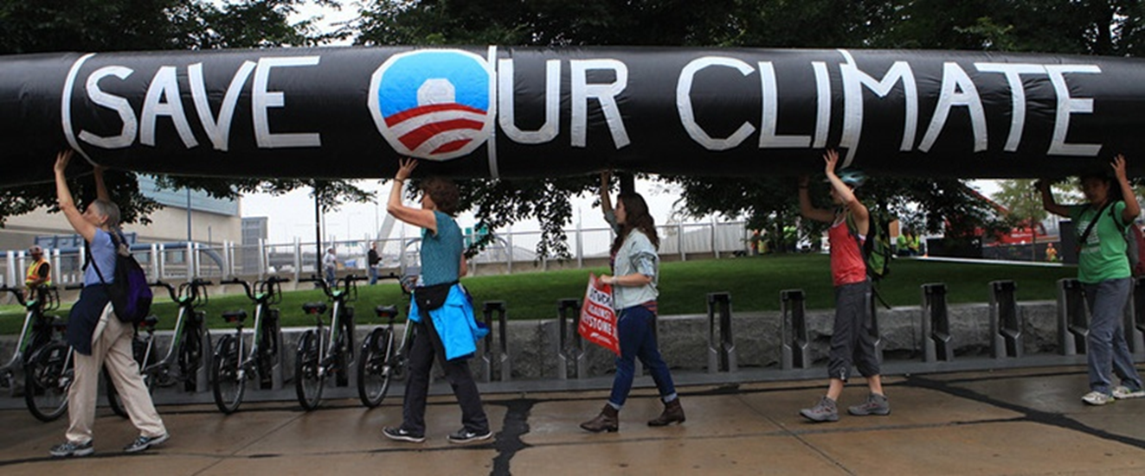
Figure 12.1
Across the country, countless people have protested, even risking arrest, against the Keystone XL Pipeline. (Credit: modification of image by “NoKXL”/Flickr Creative Commons)

Slide 3
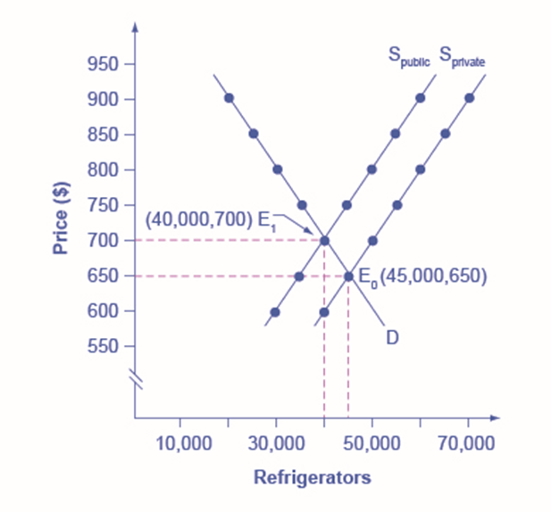
Figure 12.2
If the firm takes only its own costs of production into account, then its supply curve will be S_{private}, and the market equilibrium will occur at E₀. Accounting for additional external costs of $100 for every unit produced, the firm’s supply curve will be S_{social}. The new equilibrium will occur at E₁.

Slide 4
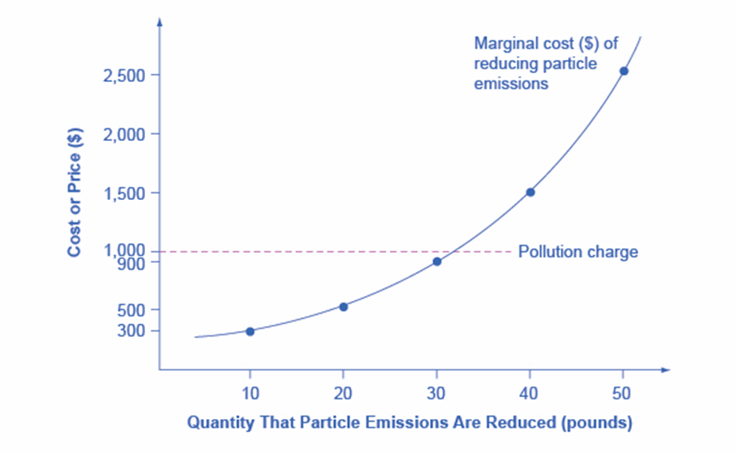
Figure 12.3
If a pollution charge is set equal to $1,000, then the firm will have an incentive to reduce pollution by 30 pounds because the $900 cost of these reductions would be less than the cost of paying the pollution charge.

Slide 5
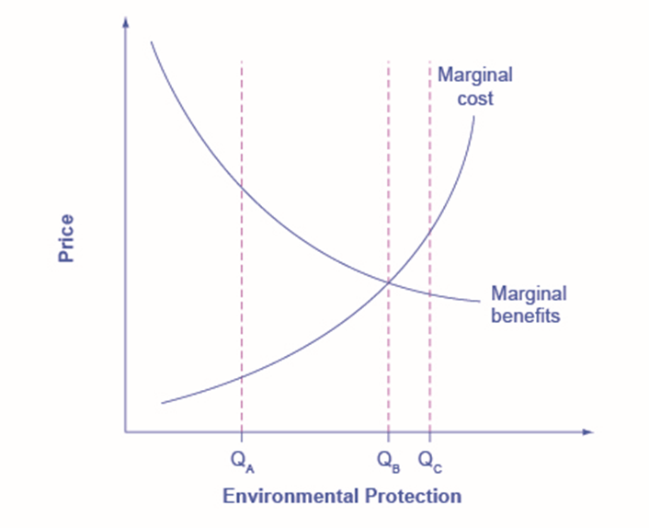
Figure 12.4
Reducing pollution is costly—resources must be sacrificed. The marginal costs of reducing pollution are generally increasing, because the least expensive and easiest reductions can be made first, leaving the more expensive methods for later. The marginal benefits of reducing pollution are generally declining, because the steps that provide the greatest benefit can be taken first, and steps that provide less benefit can wait until later.

Slide 6
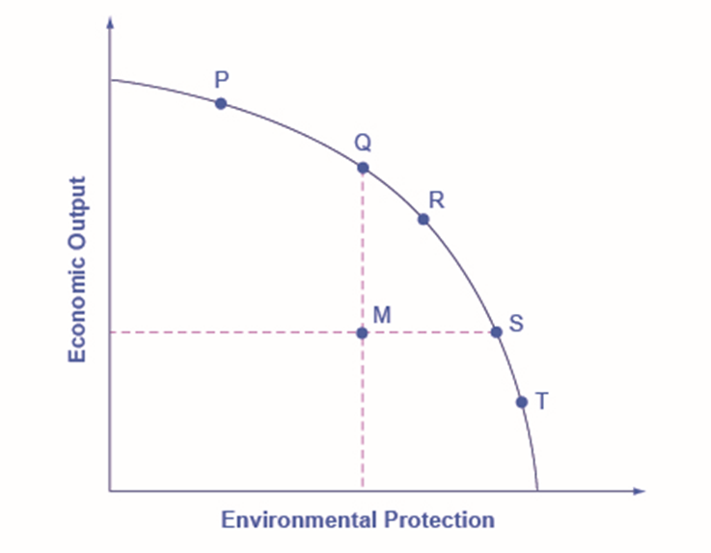
Figure 12.5
Each society will have to weigh its own values and decide whether it prefers a choice like P with more economic output and less environmental protection, or a choice like T with more environmental protection and less economic output.

