Slide 1

Principles of microEconomics
Chapter 3 Demand and Supply
PowerPoint Image Slideshow

Slide 2

Figure 3.1
Organic vegetables and fruits that are grown and sold within a specific geographical region should, in theory, cost less than conventional produce because the transportation costs are less. That is not, however, usually the case. (Credit: modification of work by Natalie Maynor/Flickr Creative Commons)

Slide 3
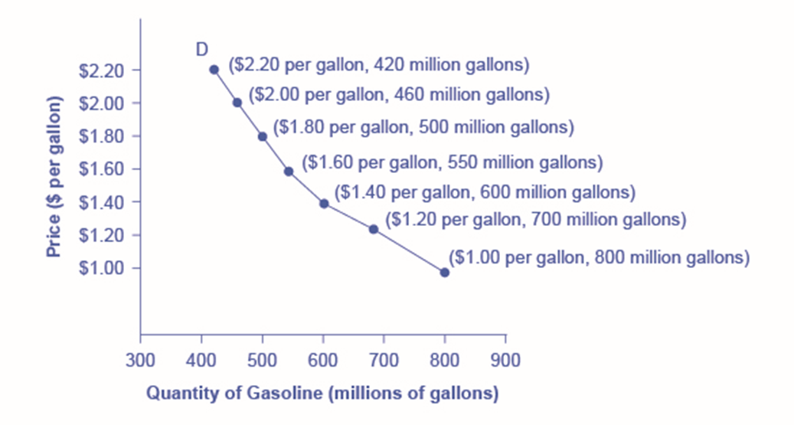
Figure 3.2
The demand schedule shows that as price rises, quantity demanded decreases, and vice versa. These points are then graphed, and the line connecting them is the demand curve (D). The downward slope of the demand curve again illustrates the law of demand—the inverse relationship between prices and quantity demanded.

Slide 4
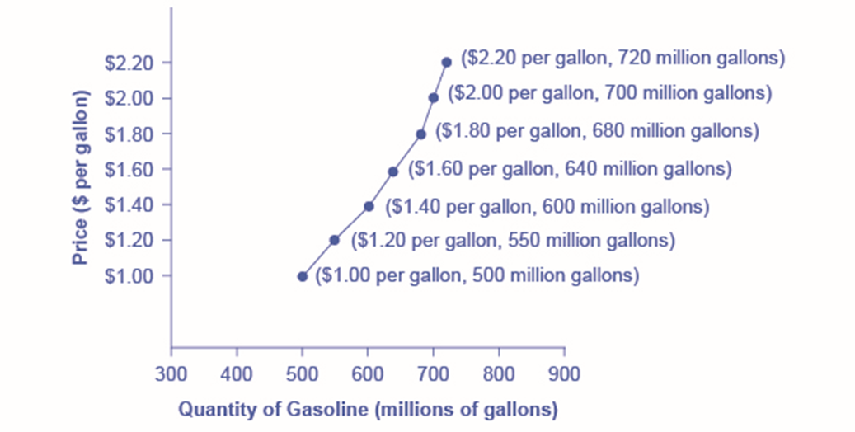
Figure 3.3
The supply schedule is the table that shows quantity supplied of gasoline at each price. As price rises, quantity supplied also increases, and vice versa. The supply curve (S) is created by graphing the points from the supply schedule and then connecting them. The upward slope of the supply curve illustrates the law of supply—that a higher price leads to a higher quantity supplied, and vice versa.

Slide 5
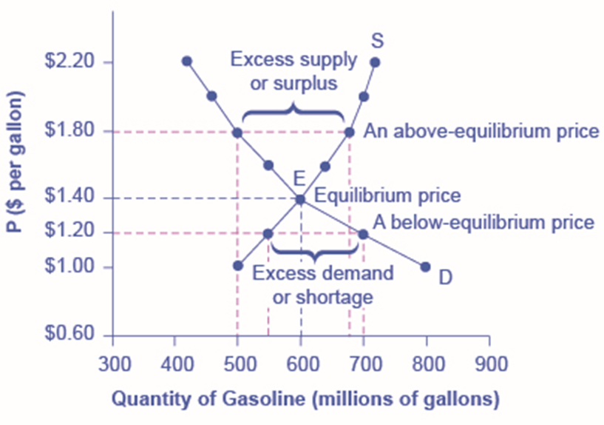
Figure 3.4
The demand curve (D) and the supply curve (S) intersect at the equilibrium point E, with a price of $1.40 and a quantity of 600. The equilibrium is the only price where quantity demanded is equal to quantity supplied. At a price above equilibrium like $1.80, quantity supplied exceeds the quantity demanded, so there is excess supply. At a price below equilibrium such as $1.20, quantity demanded exceeds quantity supplied, so there is excess demand.

Slide 6
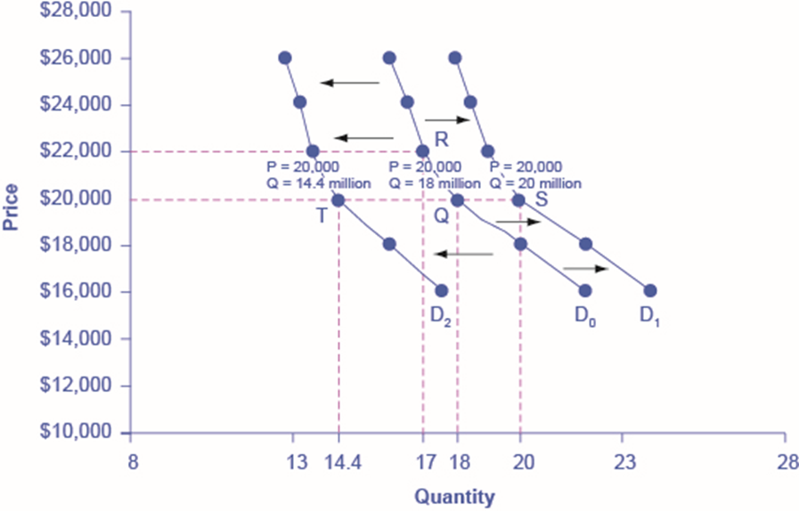
Figure 3.5
Increased demand means that at every given price, the quantity demanded is higher, so that the demand curve shifts to the right from D₀ to D₁. Decreased demand means that at every given price, the quantity demanded is lower, so that the demand curve shifts to the left from D₀ to D₂.

Slide 7
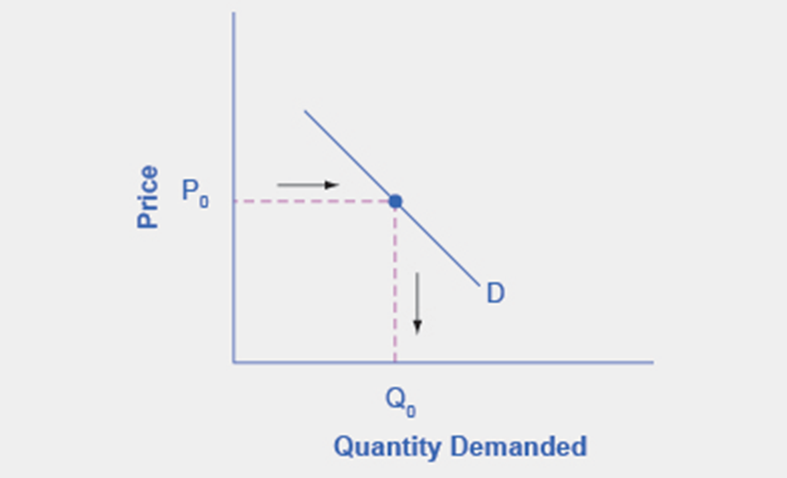
Figure 3.6
The demand curve can be used to identify how much consumers would buy at any given price.

Slide 8
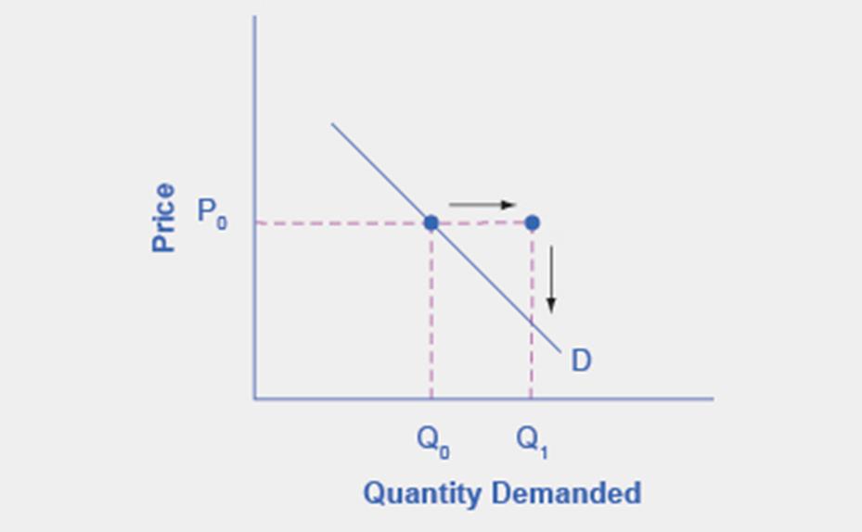
Figure 3.7
With an increase in income, consumers will purchase larger quantities, pushing demand to the right.

Slide 9
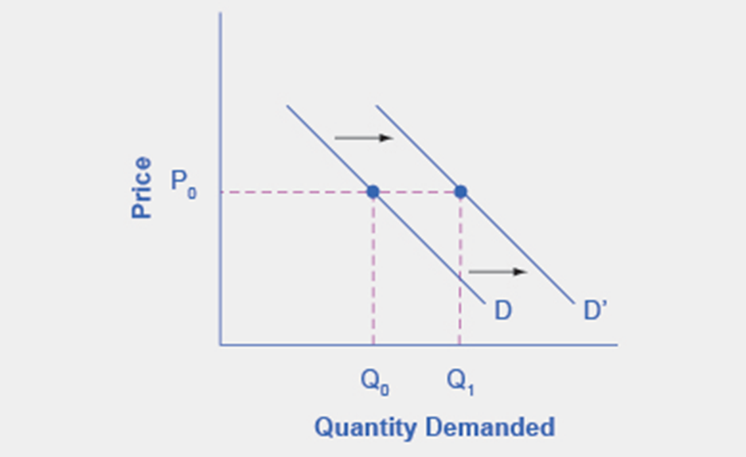
Figure 3.8
With an increase in income, consumers will purchase larger quantities, pushing demand to the right, and causing the demand curve to shift right.

Slide 10
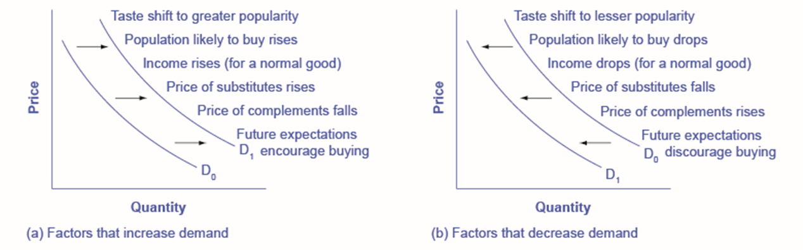
Figure 3.9
A list of factors that can cause an increase in demand from D₀ to D₁.
The same factors, if their direction is reversed, can cause a decrease in demand from D₀ to D₁.

Slide 11
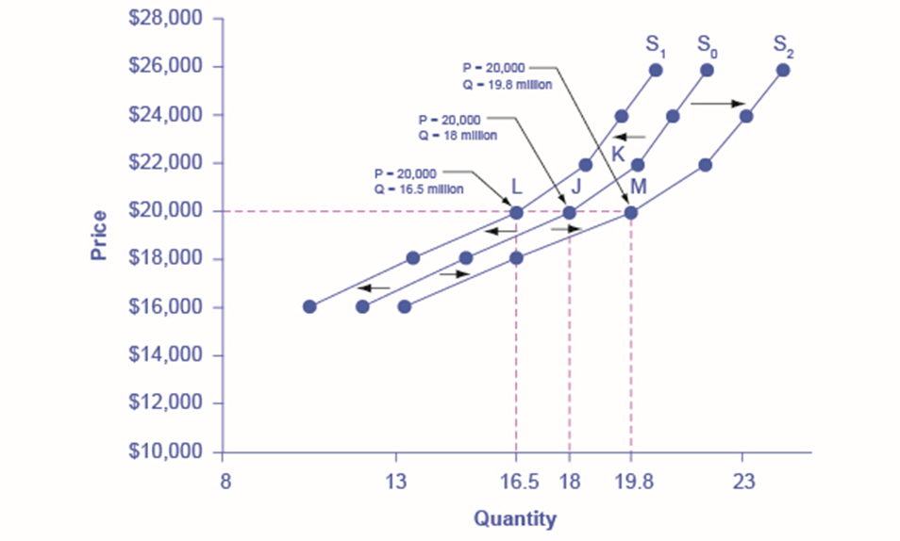
Figure 3.10
Decreased supply means that at every given price, the quantity supplied is lower, so that the supply curve shifts to the left, from S₀ to S₁. Increased supply means that at every given price, the quantity supplied is higher, so that the supply curve shifts to the right, from S₀ to S₂.

Slide 12
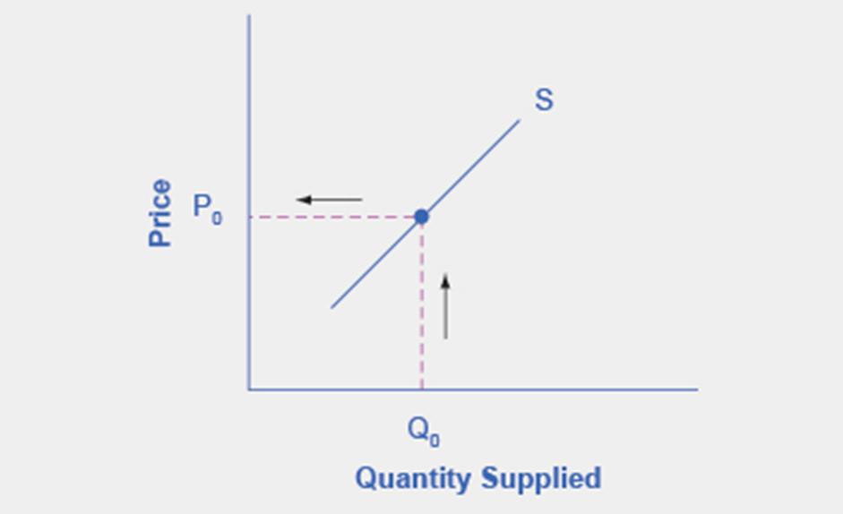
Figure 3.11
The supply curve can be used to show the minimum price a firm will accept to produce a given quantity of output.

Slide 13
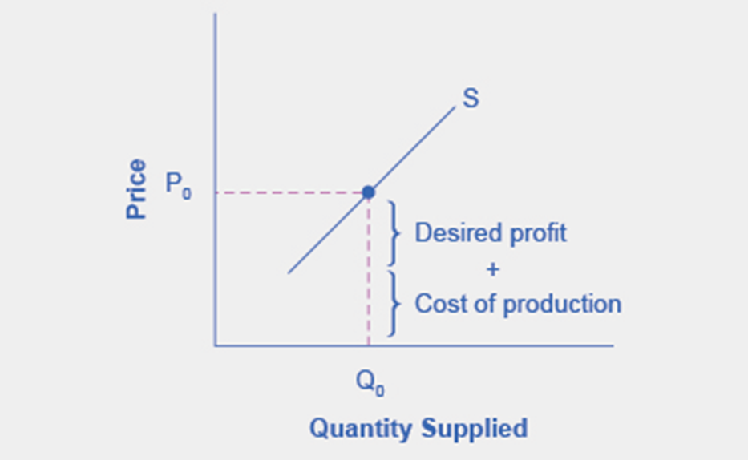
Figure 3.12
The cost of production and the desired profit equal the price a firm will set for a product.

Slide 14
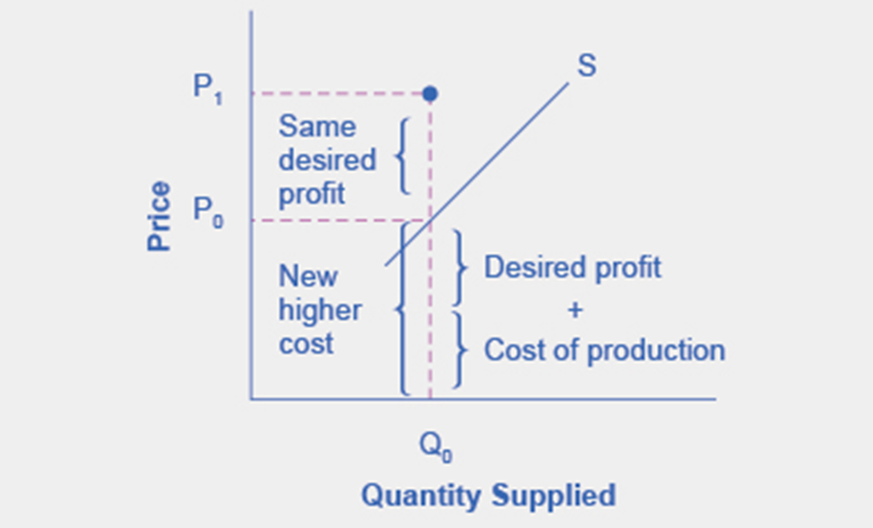
Figure 3.13
Because the cost of production and the desired profit equal the price a firm will set for a product, if the cost of production increases, the price for the product will also need to increase.

Slide 15
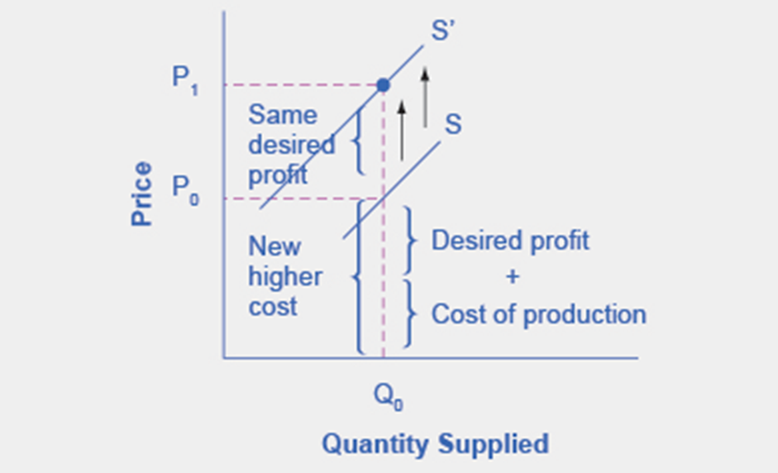
Figure 3.14
When the cost of production increases, the supply curve shifts upwardly to a new price level.

Slide 16
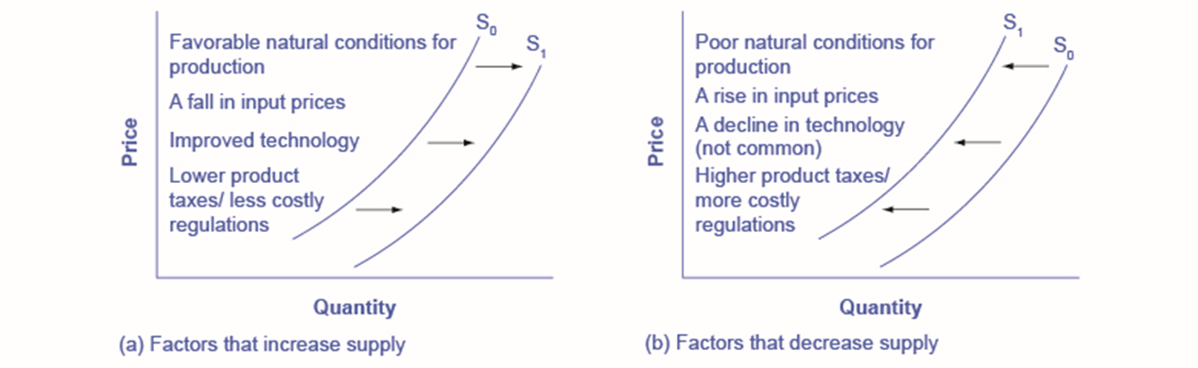
Figure 3.15
A list of factors that can cause an increase in supply from S₀ to S₁.
The same factors, if their direction is reversed, can cause a decrease in supply from S₀ to S₁.

Slide 17
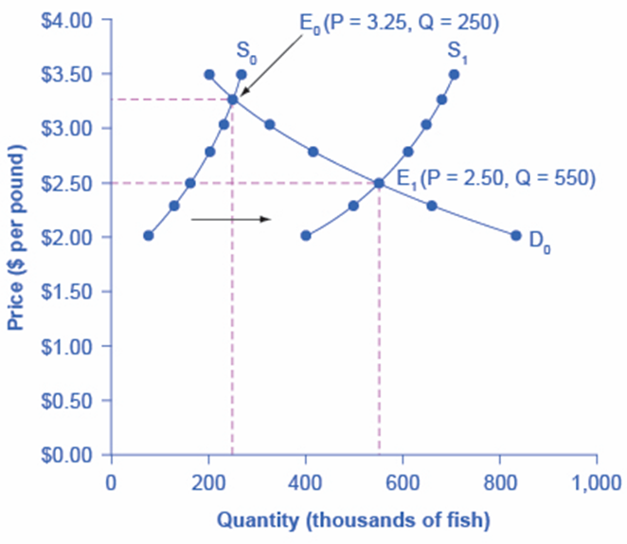
Figure 3.16
Unusually good weather leads to changes in the price and quantity of salmon.

Slide 18
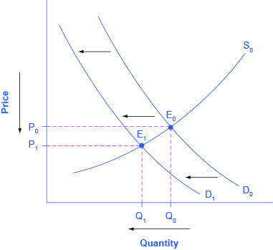
Figure 3.17
A change in tastes from print news sources to digital sources results in a leftward shift in demand for the former. The result is a decrease in both equilibrium price and quantity.

Slide 19
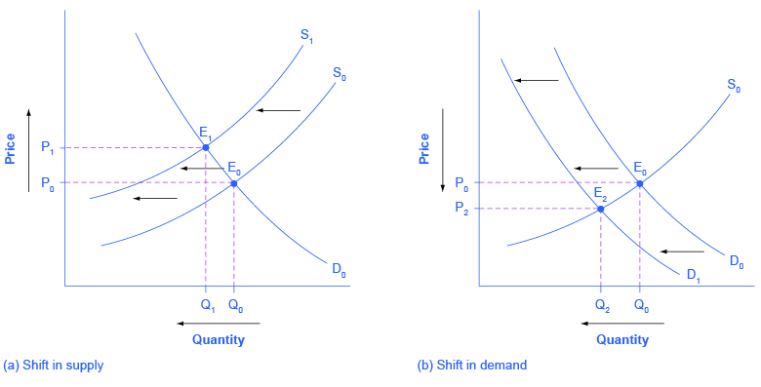
Figure 3.18
Higher labor compensation causes a leftward shift in the supply curve, a decrease in the equilibrium quantity, and an increase in the equilibrium price.
A change in tastes away from Postal Services causes a leftward shift in the demand curve, a decrease in the equilibrium quantity, and a decrease in the equilibrium price.

Slide 20
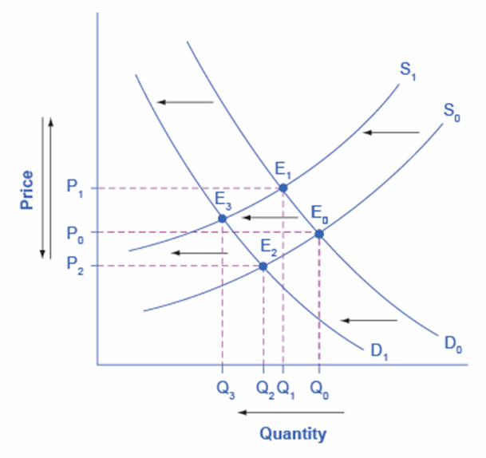
Figure 3.19
Supply and demand shifts cause changes in equilibrium price and quantity.

Slide 21
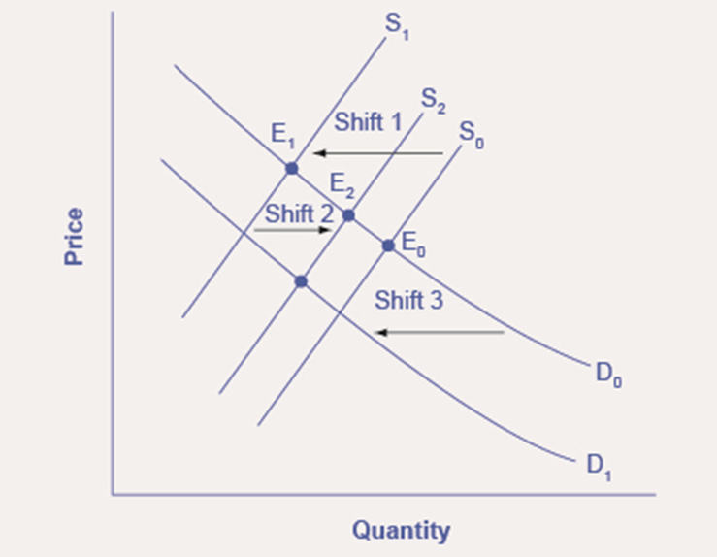
Figure 3.20
A shift in one curve never causes a shift in the other curve. Rather, a shift in one curve causes a movement along the second curve.

Slide 22
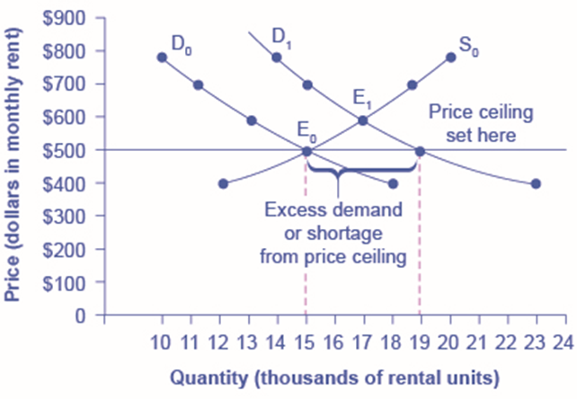
Figure 3.21
The original intersection of demand and supply occurs at E₀. If demand shifts from D₀ to D₁, the new equilibrium would be at E₁—unless a price ceiling prevents the price from rising. If the price is not permitted to rise, the quantity supplied remains at 15,000. However, after the change in demand, the quantity demanded rises to 19,000, resulting in a shortage.

Slide 23
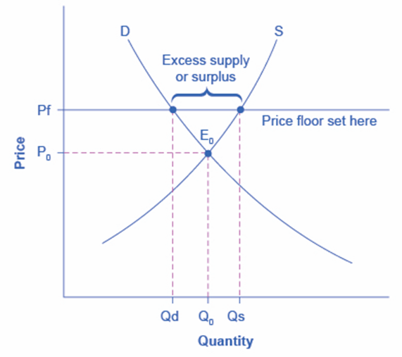
Figure 3.22
The intersection of demand (D) and supply (S) would be at the equilibrium point E₀. However, a price floor set at Pf holds the price above E₀ and prevents it from falling. The result of the price floor is that the quantity supplied Qs exceeds the quantity demanded Qd. There is excess supply, also called a surplus.

Slide 24
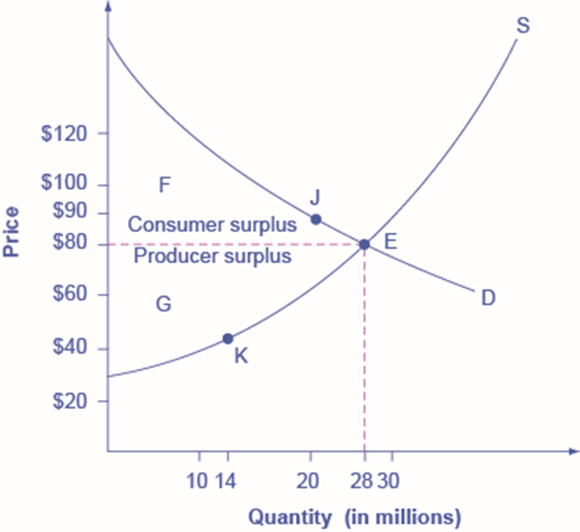
Figure 3.23
The somewhat triangular area labeled by F shows the area of consumer surplus, which shows that the equilibrium price in the market was less than what many of the consumers were willing to pay. Point J on the demand curve shows that, even at the price of $90, consumers would have been willing to purchase a quantity of 20 million. The somewhat triangular area labeled by G shows the area of producer surplus, which shows that the equilibrium price received in the market was more than what many of the producers were willing to accept for their products. For example, point K on the supply curve shows that at a price of $45, firms would have been willing to supply a quantity of 14 million.

Slide 25
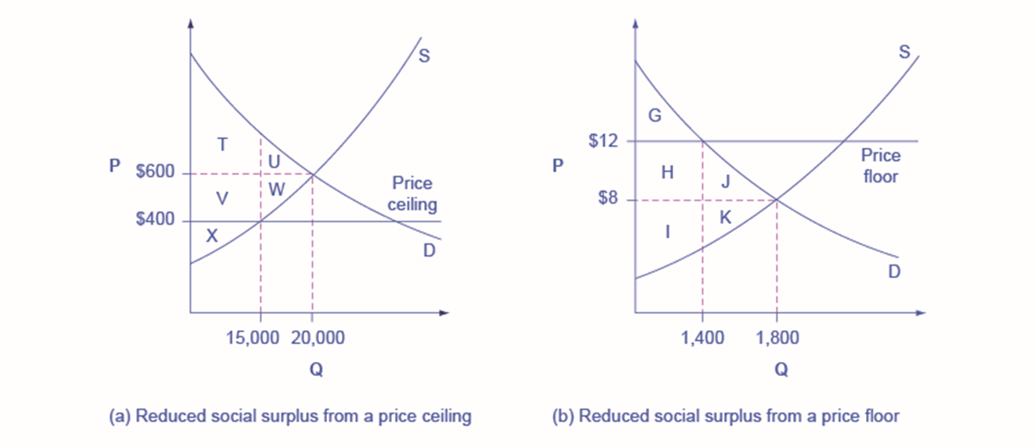
Figure 3.25
The original equilibrium price is $600 with a quantity of 20,000. Consumer surplus is T + U, and producer surplus is V + W + X. A price ceiling is imposed at $400, so firms in the market now produce only a quantity of 15,000. As a result, the new consumer surplus is T + V, while the new producer surplus is X.
The original equilibrium is $8 at a quantity of 1,800. Consumer surplus is G + H + J, and producer surplus is I + K. A price floor is imposed at $12, which means that quantity demanded falls to 1,400. As a result, the new consumer surplus is G, and the new producer surplus is H + I.

