Slide 1

Principles of microEconomics
Chapter 7
Production, Cost and Industry Structure

Slide 2

Figure 7.1
Amazon is an American international electronic commerce company that sells books, among many other things, shipping them directly to the consumer. There is no brick-and-mortar Amazon store. (Credit: modification of work by William Christiansen/Flickr Creative Commons)

Slide 3
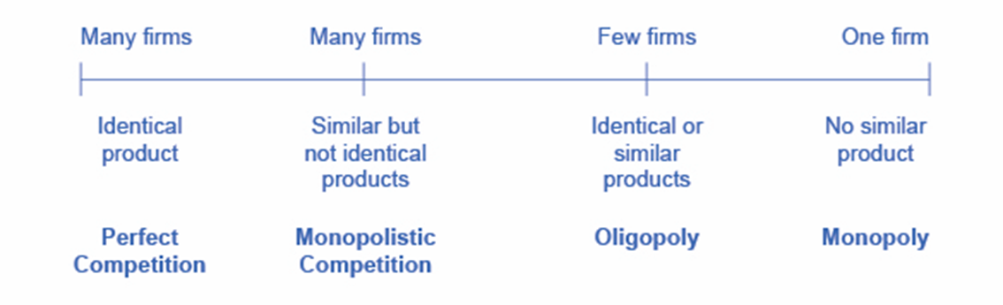
Figure 7.2
Firms face different competitive situations. At one extreme—perfect competition—many firms are all trying to sell identical products. At the other extreme—monopoly—only one firm is selling the product, and this firm faces no competition. Monopolistic competition and oligopoly fall between the extremes of perfect competition and monopoly. Monopolistic competition is a situation with many firms selling similar, but not identical, products. Oligopoly is a situation with few firms that sell identical or similar products.

Slide 4
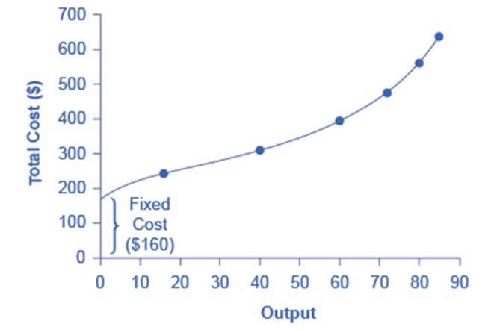
Figure 7.3
At zero production, the fixed costs of $160 are still present. As production increases, variable costs are added to fixed costs, and the total cost is the sum of the two.

Slide 5
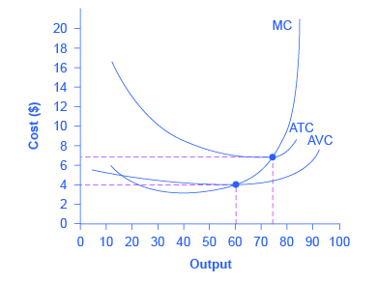
Figure 7.4
The information on total costs, fixed cost, and variable cost can also be presented on a per-unit basis. Average total cost (ATC) is calculated by dividing total cost by the total quantity produced. The average total cost curve is typically U-shaped. Average variable cost (AVC) is calculated by dividing variable cost by the quantity produced. The average variable cost curve lies below the average total cost curve and is typically U-shaped or upward-sloping. Marginal cost (MC) is calculated by taking the change in total cost between two levels of output and dividing by the change in output. The marginal cost curve is upward-sloping.

Slide 6
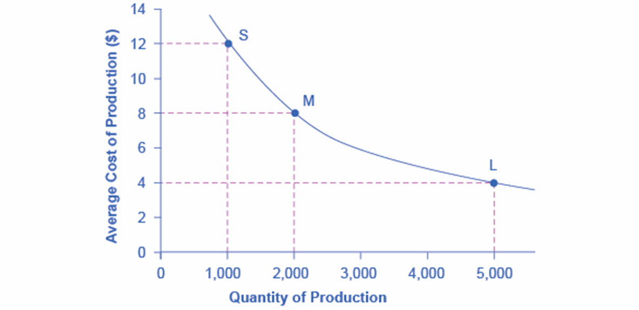
Figure 7.5
A small factory like S produces 1,000 alarm clocks at an average cost of $12 per clock. A medium factory like M produces 2,000 alarm clocks at a cost of $8 per clock. A large factory like L produces 5,000 alarm clocks at a cost of $4 per clock. Economies of scale exist because the larger scale of production leads to lower average costs.

Slide 7
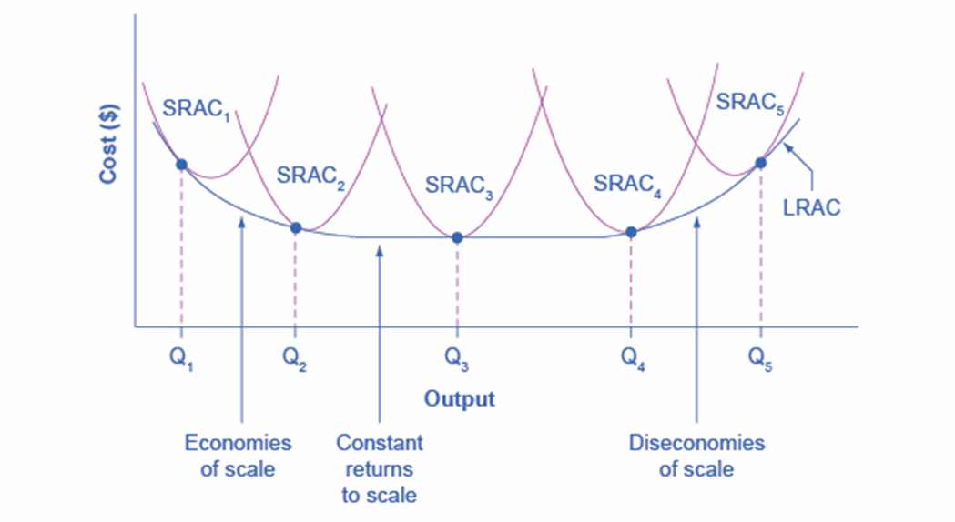
Figure 7.6
The five different short-run average cost (SRAC) curves each represents a different level of fixed costs, from the low level of fixed costs at SRAC₁ to the high level of fixed costs at SRAC₅. Other SRAC curves, not shown in the diagram, lie between the ones that are shown here. The long-run average cost (LRAC) curve shows the lowest cost for producing each quantity of output when fixed costs can vary, and so it is formed by the bottom edge of the family of SRAC curves. If a firm wished to produce quantity Q₃, it would choose the fixed costs associated with SRAC₃.

Slide 8
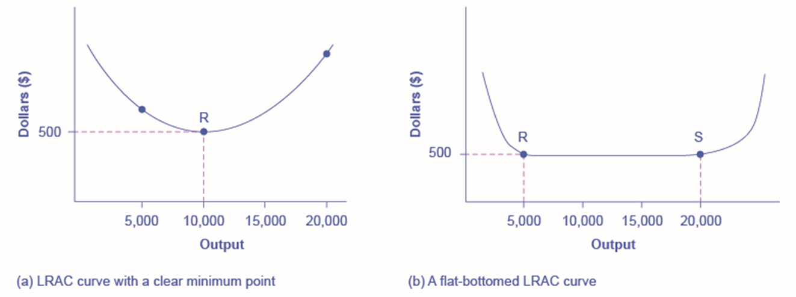
Chapter 7.7
Low-cost firms will produce at output level R. When the LRAC curve has a clear minimum point, then any firm producing a different quantity will have higher costs. In this case, a firm producing at a quantity of 10,000 will produce at a lower average cost than a firm producing, say, 5,000 or 20,000 units.
Low-cost firms will produce between output levels R and S. When the LRAC curve has a flat bottom, then firms producing at any quantity along this flat bottom can compete. In this case, any firm producing a quantity between 5,000 and 20,000 can compete effectively, although firms producing less than 5,000 or more than 20,000 would face higher average costs and be unable to compete.

