Slide 1

Principles of microEconomics
Chapter 14 Poverty and Economic Inequality
PowerPoint Image Slideshow

Slide 2
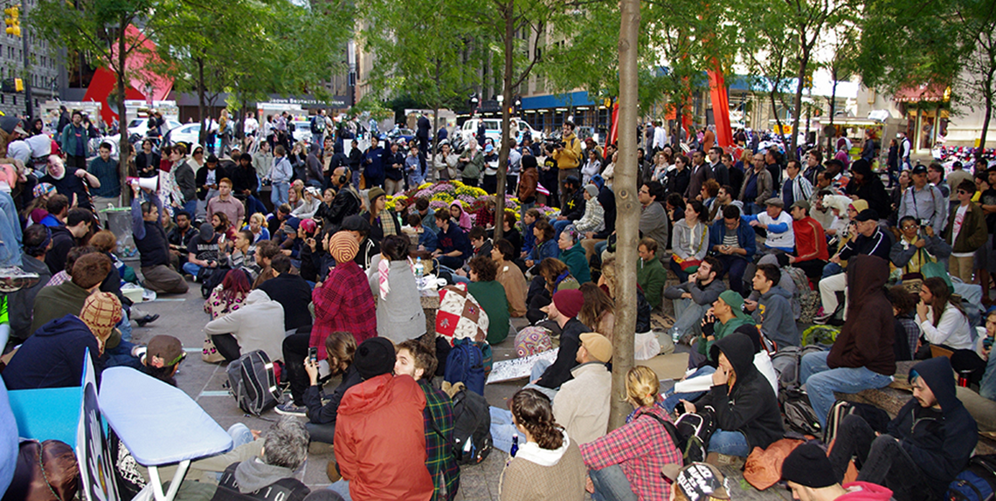
Figure 14.1
On September 17, 2011, Occupy Wall Street began in New York City’s Wall Street financial district. (Credit: modification of work by David Shankbone/Flickr Creative Commons)

Slide 3
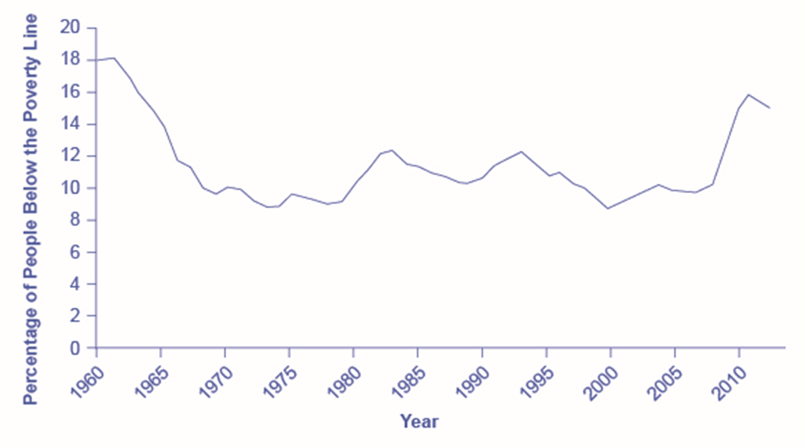
Figure 14.2
The poverty rate fell dramatically during the 1960s, rose in the early 1980s and early 1990s, and, after declining in the 1990s through mid-2000s, rose to 15.9% in 2011, which is close to the 1960 levels. In 2012, the poverty dropped slightly to 15.0%. (Source: U.S. Census Bureau)

Slide 4
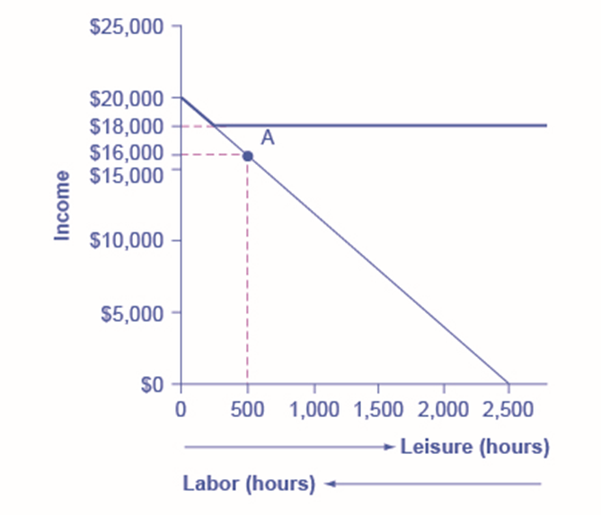
Figure 14.3
The original choice is 500 hours of leisure, 2,000 hours of work at point A, and income of $16,000. With a guaranteed income of $18,000, this family would receive $18,000 whether it provides zero hours of work or 2,000 hours of work. Only if the family provides, say, 2,300 hours of work does its income rise above the guaranteed level of $18,000—and even then, the marginal gain to income from working many hours is small.

Slide 5
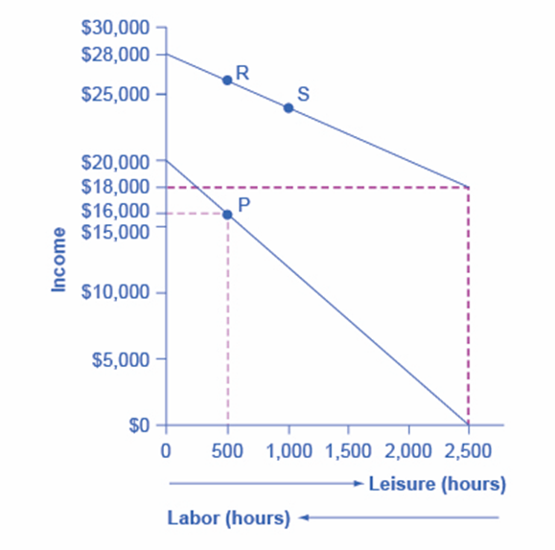
Figure 14.4
On the original labor-leisure opportunity set, the lower budget set shown by the smaller dashed line in the figure, the preferred choice P is 500 hours of leisure and $16,000 of income. Then, the government created an antipoverty program that guarantees $18,000 in income even to those who work zero hours, shown by the larger dashed line. In addition, every $1 earned means phasing out 50 cents of benefits. This program leads to the higher budget set shown in the diagram. The hope is that this program will provide incentives to work the same or more hours, despite receiving income assistance. However, it is possible that the recipients will choose a point on the new budget set like S, with less work, more leisure, and greater income, or a point like R, with the same work and greater income.

Slide 6
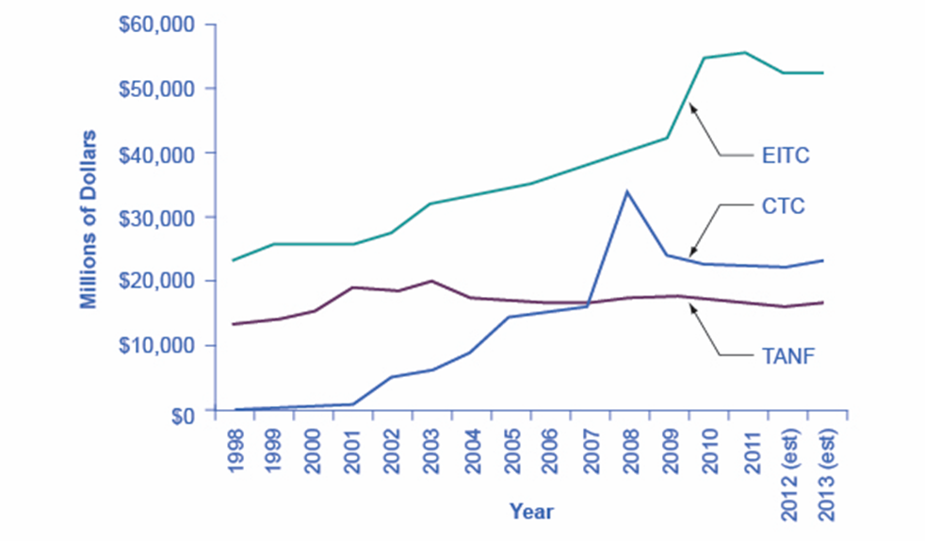
Figure 14.5
EITC increased from more than $20 billion in 2000 to over an estimated $50 billion by 2013, far exceeding estimated 2013 outlays in the CTC (Child Tax Credits) and TANF of over $20 billion and $10 billion, respectively. (Source: Office of Management and Budget)

Slide 7
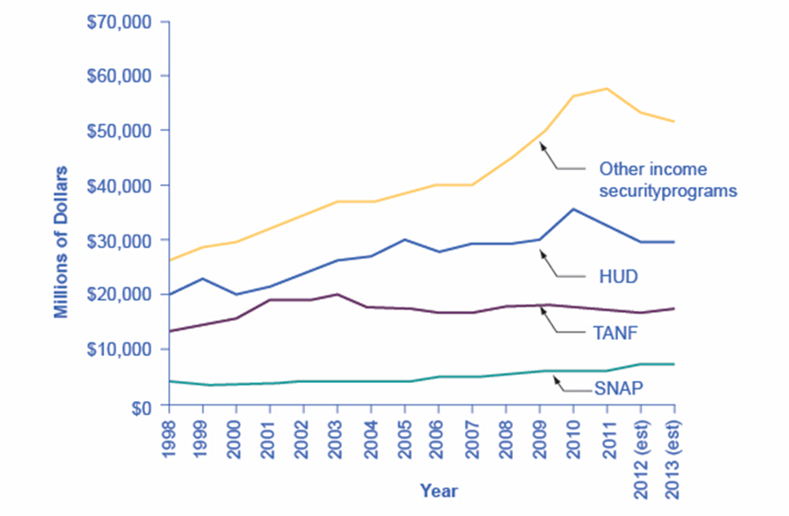
Figure 14.6
Total expenditures on income security continued to rise between 1988 and 2010, while payments for TANF have increased from $13 billion in 1998 to an estimated $17.3 billion in 2013. SNAP has seen relatively small increments. These two programs comprise a relatively small portion of the estimated $106 billion dedicated to income security in 2013. Note that other programs and housing programs increased dramatically during the 2008 and 2010 time periods. (Source: Table 12.3 Section 600 Income Security, http://www.whitehouse.gov/sites/default/files/omb/budget/fy2013/assets/hist.pdf)

Slide 8
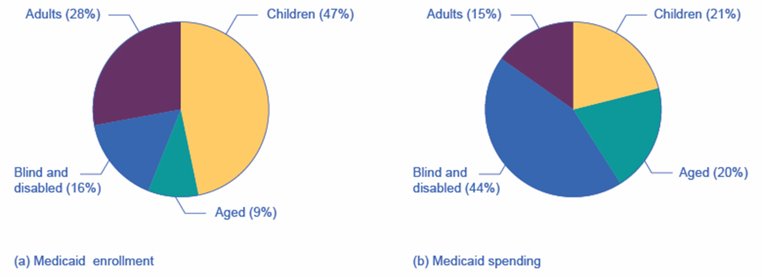
Figure 14.7
Part (a) shows the Medicaid enrollment by different populations, with children comprising the largest percentage at 47%, followed by adults at 28%, and the blind and disabled at 16%. Part (b) shows that Medicaid spending is principally for the blind and disabled, followed by the elderly. Although children are the largest population covered by Medicaid, expenditures on children are only at 21%.

Slide 9
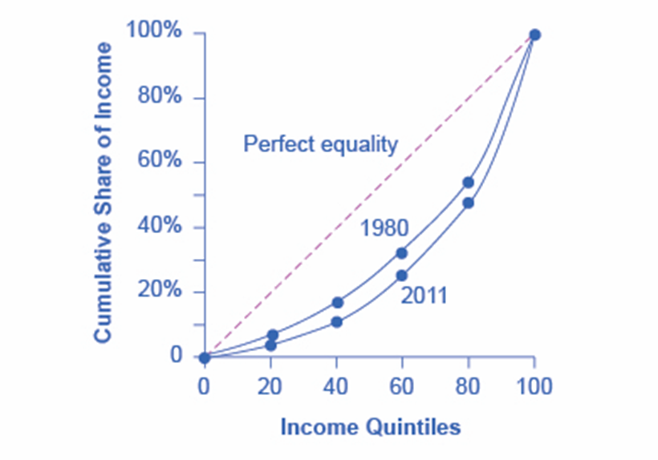
Figure 14.8
A Lorenz curve graphs the cumulative shares of income received by everyone up to a certain quintile. The income distribution in 1980 was closer to the perfect equality line than the income distribution in 2011—that is, the U.S. income distribution became more unequal over time.

Slide 10
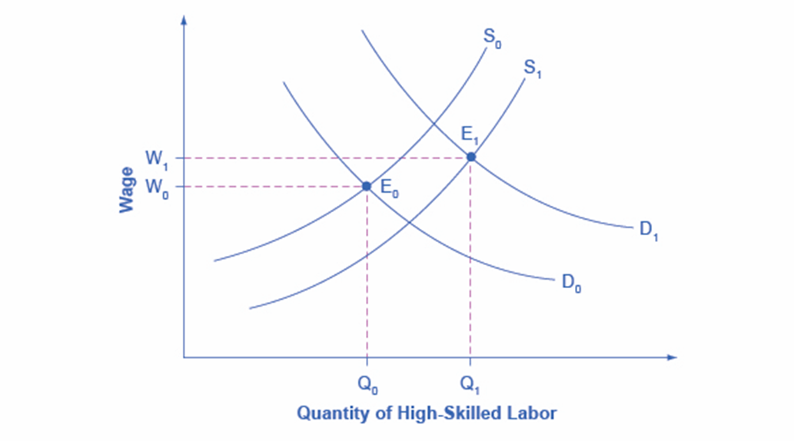
Figure 14.9
The proportion of workers attending college has increased in recent decades, so the supply curve for high-skilled labor has shifted to the right, from S₀ to S₁. If the demand for high-skilled labor had remained at D₀, then this shift in supply would have led to lower wages for high-skilled labor. However, the wages for high-skilled labor, especially if there is a large global demand, have increased even with the shift in supply to the right. The explanation must lie in a shift to the right in demand for high-skilled labor, from D₀ to D₁. The figure shows how a combination of the shift in supply, from S₀ to S₁, and the shift in demand, from D₀ to D₁, led to both an increase in the quantity of high-skilled labor hired and also to a rise in the wage for such labor, from W₀ to W₁.

Slide 11
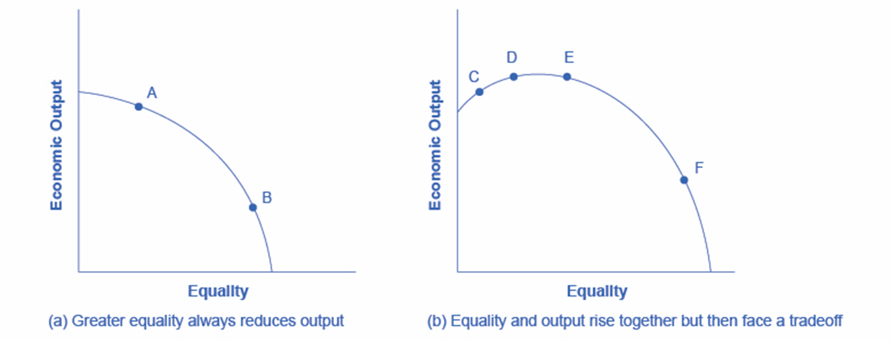
Figure 14.10
Society faces a trade-off where any attempt to move toward greater equality, like moving from choice A to B, involves a reduction in economic output.
Situations can arise like point C, where it is possible both to increase equality and also to increase economic output, to a choice like D. It may also be possible to increase equality with little impact on economic output, like the movement from choice D to E. However, at some point, too aggressive a push for equality will tend to reduce economic output, as in the shift from E to F.

