Slide 1

Principles of microEconomics
Chapter 8
Perfect Competition

Slide 2

Figure 8.1
Depending upon the competition and prices offered, a wheat farmer may choose to grow a different crop. (Credit: modification of work by Daniel X. O'Neil/Flickr Creative Commons)

Slide 3
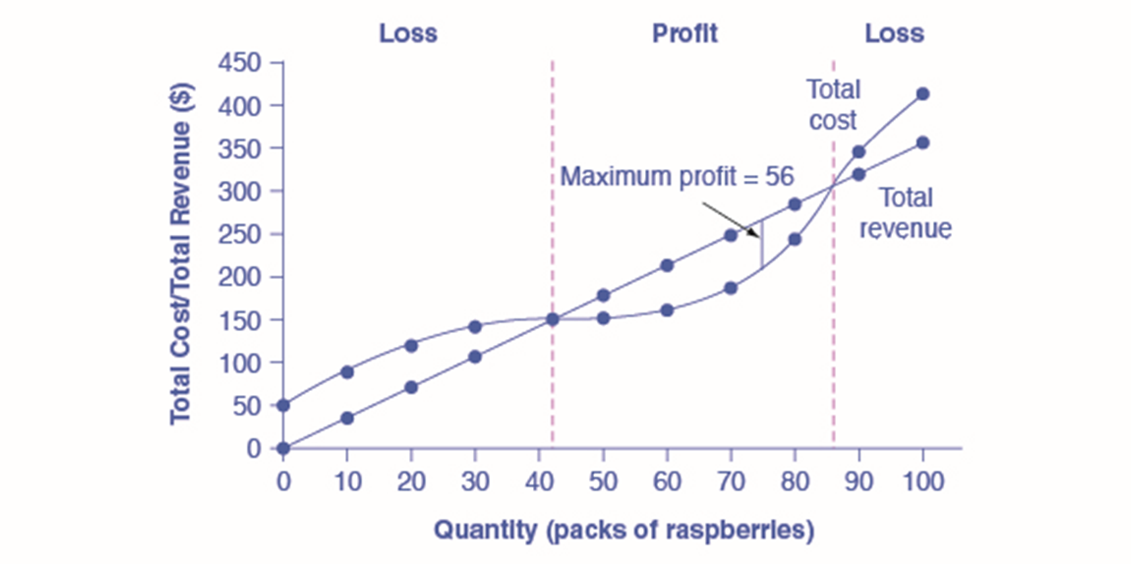
Figure 8.2
Total revenue for a perfectly competitive firm is a straight line sloping up. The slope is equal to the price of the good. Total cost also slopes up, but with some curvature. At higher levels of output, total cost begins to slope upward more steeply because of diminishing marginal returns. The maximum profit will occur at the quantity where the gap of total revenue over total cost is largest.

Slide 4
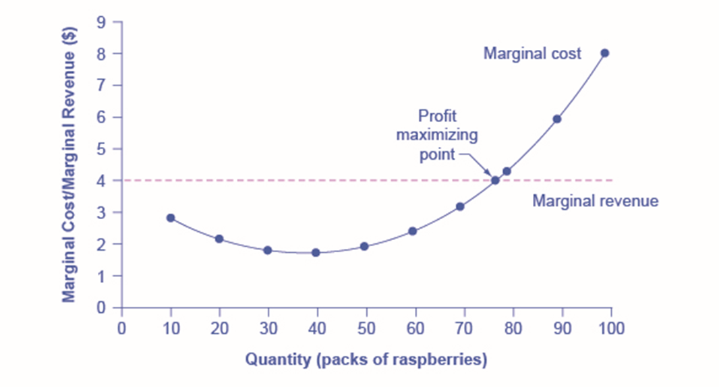
Figure 8.3
For a perfectly competitive firm, the marginal revenue (MR) curve is a horizontal straight line because it is equal to the price of the good, which is determined by the market, shown in Figure 8.4. The marginal cost (MC) curve is sometimes first downward-sloping, if there is a region of increasing marginal returns at low levels of output, but is eventually upward-sloping at higher levels of output as diminishing marginal returns kick in.

Slide 5
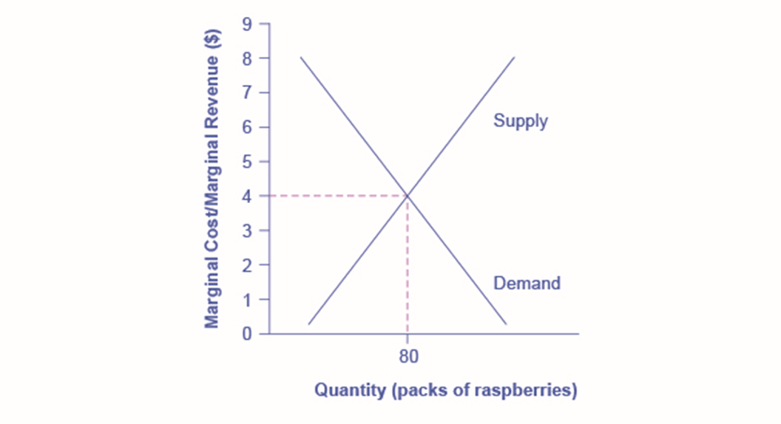
Figure 8.4
The equilibrium price of raspberries is determined through the interaction of market supply and market demand at $4.00.

Slide 6
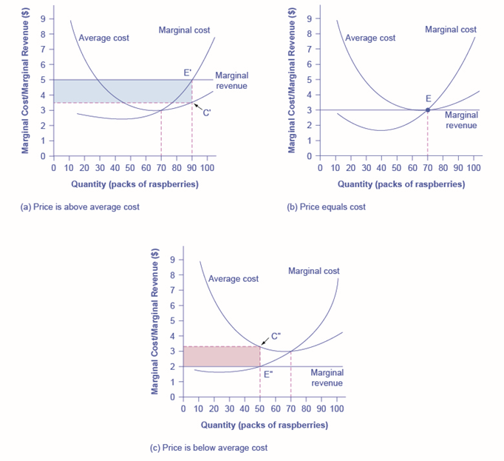
Figure 8.5
In (a), price intersects marginal cost above the average cost curve. Since price is greater than average cost, the firm is making a profit. In (b), price intersects marginal cost at the minimum point of the average cost curve. Since price is equal to average cost, the firm is breaking even. In (c), price intersects marginal cost below the average cost curve. Since price is less than average cost, the firm is making a loss.

Slide 7
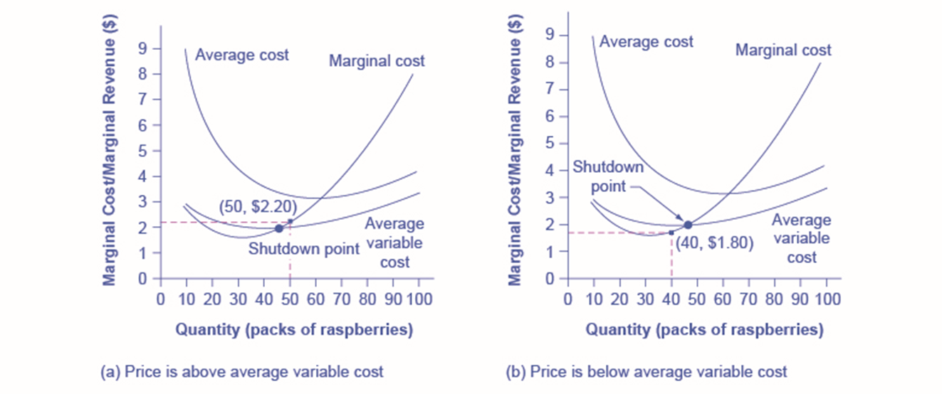
Figure 8.6
In (a), the farm produces at a level of 50. It is making losses of $56, but price is above average variable cost, so it continues to operate. In (b), total revenues are $72 and total cost is $144, for overall losses of $72. If the farm shuts down, it must pay only its fixed costs of $62. Shutting down is preferable to selling at a price of $1.80 per pack.

Slide 8
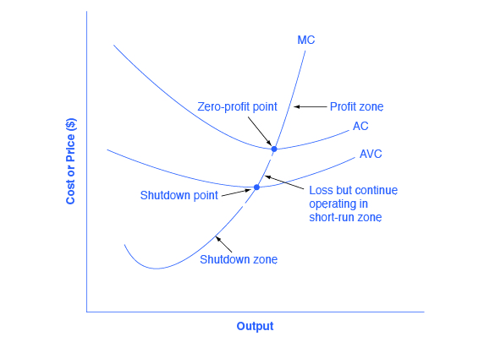
Figure 8.7
The marginal cost curve can be divided into three zones, based on where it is crossed by the average cost and average variable cost curves. The point where MC crosses AC is called the zero-profit point. If the firm is operating at a level of output where the market price is at a level higher than the zero-profit point, then price will be greater than average cost and the firm is earning profits. If the price is exactly at the zero-profit point, then the firm is making zero profits. If price falls in the zone between the shutdown point and the zero-profit point, then the firm is making losses but will continue to operate in the short run, since it is covering its variable costs. However, if price falls below the price at the shutdown point, then the firm will shut down immediately, since it is not even covering its variable costs.

Slide 9
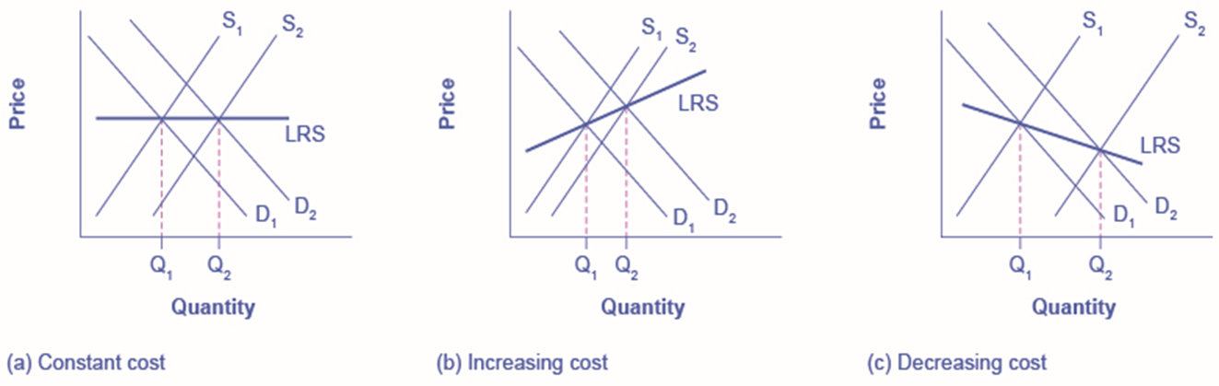
Figure 8.8
In (a), demand increased and supply met it. Notice that the supply increase is equal to the demand increase. The result is that the equilibrium price stays the same as quantity sold increases. In (b), notice that sellers were not able to increase supply as much as demand. Some inputs were scarce, or wages were rising. The equilibrium price rises. In (c), sellers easily increased supply in response to the demand increase. Here, new technology or economies of scale caused the large increase in supply, resulting in declining equilibrium price.

