Slide 1



PRINCIPLES OF
MICROECONOMICS 2e
Chapter 5 Elasticity
PowerPoint Image Slideshow

Slide 2
CH.5 OUTLINE
5.1: Price Elasticity of Demand and Price
Elasticity of Supply
5.2: Polar Cases of Elasticity and Constant
Elasticity
5.3: Elasticity and Pricing
5.4: Elasticity in Areas Other Than Price

Slide 3
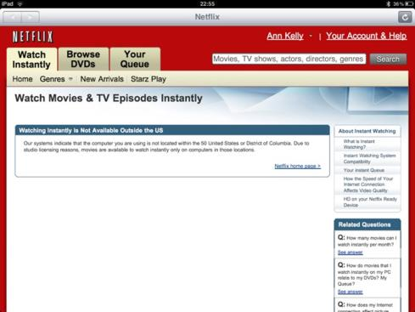
Netflix and Economic Elasticity
Netflix, Inc. is an American provider of on-demand Internet streaming media to many countries around the world, including the United States, and of flat rate DVD-by-mail in the United States. How did customers react in 2011 when it announced a major packaging change, including an increase in price? This is a modern day digital example of a concept economists call elasticity, and will be further explored in this chapter. (Credit: modification of work by Traci Lawson/Flickr Creative Commons)

Slide 4
5.1 Price Elasticity of Demand and Price Elasticity of Supply
Elasticity is an economics concept that measures the responsiveness of one variable to changes in another variable.
Price elasticity is the ratio between the percentage change in the quantity demanded (Qd) or supplied (Qs), and the corresponding percent change in price.
Price elasticity of demand - percentage change in the quantity demanded of a good or service divided the percentage
Price elasticity of supply - the percentage change in quantity supplied divided by the percentage change in price.

Slide 5
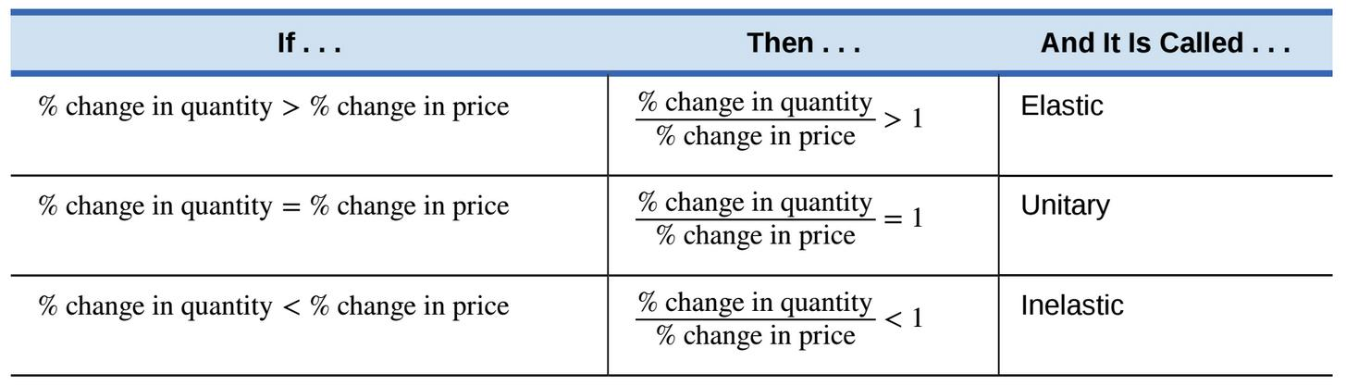
Elastic, Inelastic, and Unitary: Three Cases of Elasticity
An elastic demand or elastic supply is one in which the elasticity is greater than one, indicating a high responsiveness to changes in price.
Inelastic demand or inelastic supply - elasticities that are less than one, indicating low responsiveness to price changes.
Unitary elasticities indicate proportional responsiveness of either demand or supply,

Slide 6
Calculate Elasticity of a Curve
To calculate elasticity along a demand or supply curve economists use the average percent change in both quantity and price.
Midpoint Method for Elasticity:
% change in quantity = Q2 – Q1
(Q2 + Q1)/2
% change in price = P2 – P1
(P2 + P1)/2
x 100
x 100

Slide 7
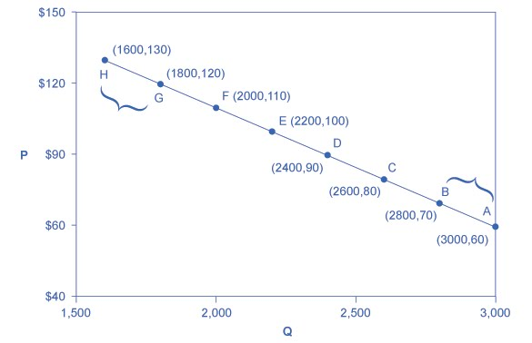
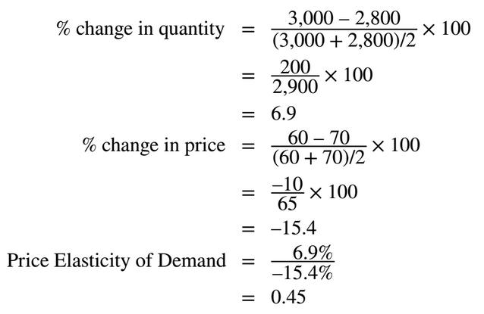
Example - Calculating the Price Elasticity
of Demand
The price elasticity of demand is calculated as the percentage change in quantity divided by the percentage change in price.
Therefore, the elasticity of demand between these two points is 0.45, an amount smaller than one, showing that the demand is inelastic in this interval.

Slide 8
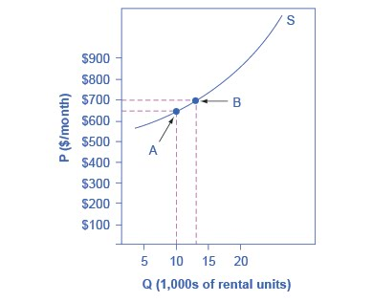
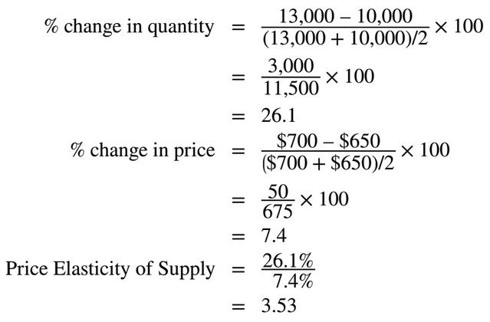
Example - Calculating the Price Elasticity
of Supply
The price elasticity of supply is calculated as the percentage change in quantity divided by the percentage change in price.
What category of elasticity does the result fall into?

Slide 9
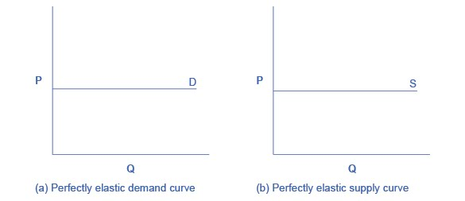
5.2 Polar Cases of Elasticity and Constant Elasticity
Infinite elasticity or perfect elasticity - either the quantity demanded (Qd) or supplied (Qs) changes by an infinite amount in response to any change in price at all.
In both cases, the supply and the demand curve are horizontal.
The quantity supplied or demanded is extremely responsive to price changes, moving from zero for prices close to P to infinite when price reach P.

Slide 10
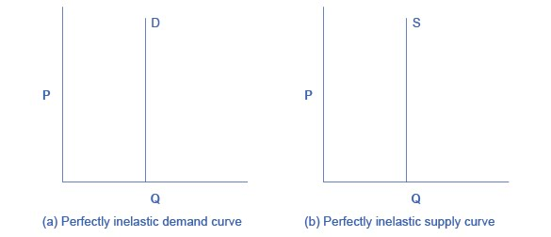
Zero Elasticity
Zero elasticity or perfect inelasticity - a percentage change in price, no matter how large, results in zero change in quantity.
The vertical supply curve and vertical demand curve show that there will be zero percentage change in quantity (a) supplied or (b) demanded, regardless of the price.

Slide 11
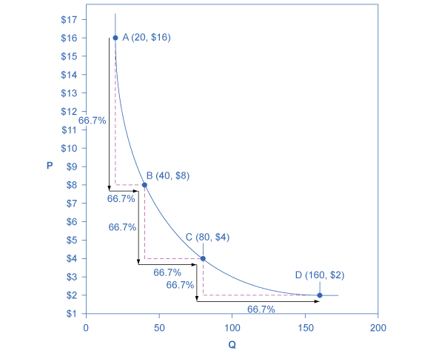
Constant Unitary Elasticity
Constant unitary elasticity, in either a supply or demand curve, occurs when a price change of one percent results in a quantity change of one percent.
A demand curve with constant unitary elasticity will be a curved line.
Notice how price and quantity demanded change by an identical amount in each step down the demand curve.

Slide 12
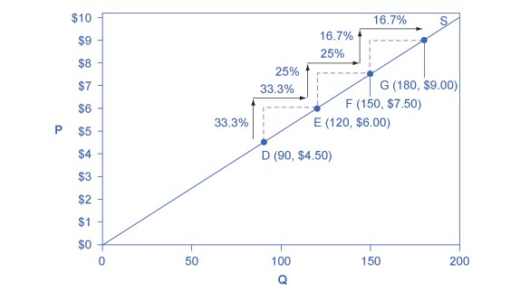
Constant Unitary Elasticity
A constant unitary elasticity supply curve is a straight line reaching up from the origin.
Between each point, the percentage increase in quantity demanded is the same as the percentage increase in price.

Slide 13
5.3 Elasticity and Pricing
Most businesses face a day-to-day struggle to figure out ways to produce at a lower cost, as one pathway to their goal of earning higher profits.
However, in some cases, the price of a key input over which the firm has no control may rise or fall.
Can businesses pass costs (or cost savings) onto consumers?

Slide 14
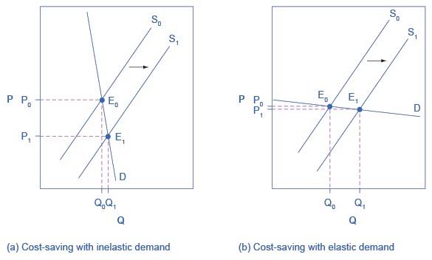
Passing Along Cost Savings to
Consumers -Technological Improvements
Cost-saving gains cause supply to shift out to the right from S₀ to S₁; that is, at any given price, firms will be willing to supply a greater quantity.
If demand is inelastic, as in (a), the result of this cost-saving technological improvement will be substantially lower prices.
If demand is elastic, as in (b), the result will be only slightly lower prices.
Consumers benefit in either case, from a greater quantity at a lower price, but the benefit is greater when demand is inelastic, as in (a).

Slide 15
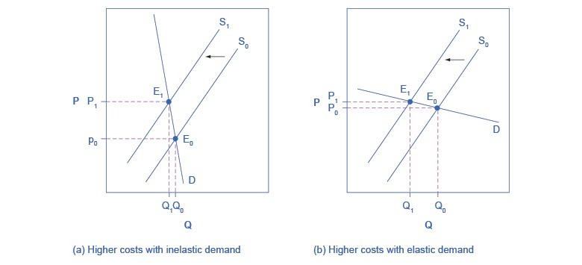
Passing Along Higher Costs to
Consumers - Rising Taxes
Higher costs, like a higher tax on cigarette companies for example, lead supply to shift to the left. This shift is identical in (a) and (b).
However, in (a), where demand is inelastic, the cost increase can largely be passed along to consumers in the form of higher prices, without much of a decline in equilibrium quantity.
In (b), demand is elastic, so the shift in supply results primarily in a lower equilibrium quantity.
Consumers suffer in either case, but in (a), they suffer from paying a higher price for the same quantity, while in (b), they suffer from buying a lower quantity (and presumably needing to shift their consumption elsewhere).

Slide 16
Elasticity and Tax Incidence
Tax incidence - manner in which the tax burden is divided between buyers and sellers.
If demand is more inelastic than supply, consumers bear most of the tax burden.
If supply is more inelastic than demand, sellers bear most of the tax burden.

Slide 17
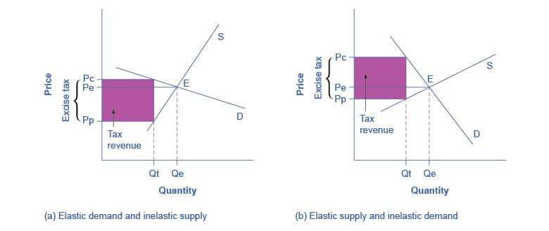
Elasticity and Tax Incidence
An excise tax introduces a wedge between the price paid by consumers (Pc) and the price received by producers (Pp).
The more elastic the demand and supply curves are, the lower the tax revenue.
When the demand is more elastic than supply, the tax incidence on consumers, Pc – Pe, is lower than the tax incidence on producers, Pe – Pp.
When the supply is more elastic than demand, the tax incidence on consumers, Pc – Pe, is larger than the tax incidence on producers, Pe – Pp.

Slide 18
Long-Run vs. Short-Run Impact
Elasticities are often lower in the short run than in the long run.
On the demand side of the market, it can sometimes be difficult to change Qd in the short run, but easier in the long run.
On the supply side of markets, producers of goods and services typically find it easier to expand production in the long term of several years rather than in the short run of a few months.
In most markets for goods and services:
  in the short run - prices bounce up and down more than quantities.
  in the long run - quantities often move more than prices.

Slide 19
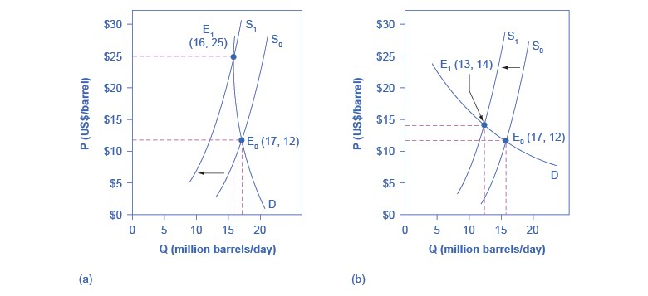
Responsiveness of Demand to Price
Changes of Crude Oil
shows inelastic demand for oil in the short run
more elastic demand over the long term.
The intersection (E₀) between demand curve D and supply curve S₀ is the same in both (a) and (b).
The shift of supply to the left from S₀ to S₁ is identical in both (a) and (b).
The new equilibrium (E₁) has a higher price and a lower quantity than the original equilibrium (E₀) in both (a) and (b).
However, the shape of the demand curve D is different in (a) and (b).
As a result, the shift in supply can result either in a new equilibrium with a much higher price and an only slightly smaller quantity, as in (a).
Or in a new equilibrium with only a small increase in price and a relatively larger reduction in quantity, as in (b).

Slide 20
5.4 Elasticity in Areas Other Than Price
Income elasticity of demand
% change in quantity demanded
% change in income
For most products, most of the time, the income elasticity of demand is positive:
That is, a rise in income will cause an increase in the quantity demanded.
=

Slide 21
Cross-Price Elasticity of Demand
A change in the price of one good can shift the quantity demanded for another good.
Cross-price elasticity of demand - the percentage change in the quantity of good A that is demanded as a result of a percentage change in the price good B.
% change in Qd of good A
% change in price of good B
Discussion Question: What are examples of complement and substitute goods, where a change in price of one good would cause a change in demand of the other?
=

Slide 22
Elasticity in Labor
Wage elasticity of labor supply - the percentage change in labor supplied divided by the percentage change in wages.
% change in quantity of labor supplied
% change in wage
Wage elasticity of labor demand - the percentage change in labor demanded divided by the percentage change in wages.
% change in quantity of labor demanded
% change in wage
=
=

Slide 23
Elasticity in Financial Capital Markets
Interest rate elasticity of savings - the percentage change in the quantity of savings divided by the percentage change in interest rates.
% change in quantity of financial savings
% change in interest rate
Interest rate elasticity of borrowing - the percentage change in the quantity of borrowing divided by the percentage change in interest rates.
% change in quantity of financial borrowing
% change in interest rate
=
=

Slide 24
Back to Netflix
How did the 60% price increase in 2011 end up for Netflix?
Before the price increase - 24.6 million U.S. subscribers.
After the price increase - 810,000 U.S. consumers canceled their subscriptions.
Fast forward to June 2013, there were 36 million streaming Netflix subscribers in the United States.
  An average per quarter growth of about 1.6 million.
  This was less than the 2 million per quarter increases that had been the previous norm, before the price change.
Why was the estimate of customers leaving so far off? What missteps did the Netflix management make?
A misjudgement of the elasticity of demand.
  Due to increase in the number of close substitutes (Vudu, Amazon Prime, Hulu, Redbox).
Misjudgement of customers’ preferences and tastes.
  Many consumers still preferred a physical DVD disk over streaming video.

Slide 25
This OpenStax ancillary resource is © Rice University under a CC-BY 4.0 International license; it may be reproduced or modified but must be attributed to OpenStax, Rice University and any changes must be noted.

