Slide 1

Principles of microEconomics
Chapter 4 Labor and Financial Markets
PowerPoint Image Slideshow

Slide 2

Figure 4.1
People often think of demand and supply in relation to goods, but labor markets, such as the nursing profession, can also apply to this analysis. (Credit: modification of work by "Fotos GOVBA"/Flickr Creative Commons)

Slide 3
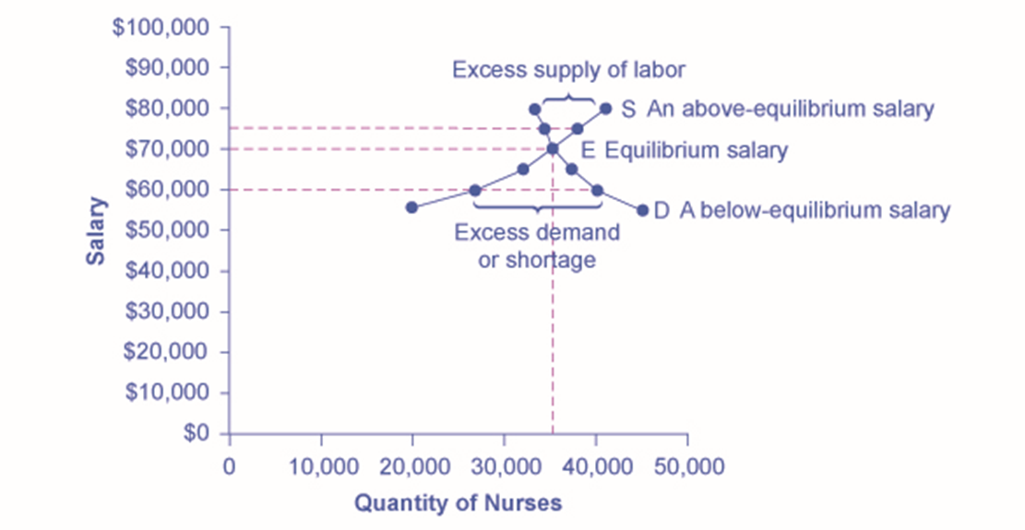
Figure 4.2
The demand curve (D) of those employers who want to hire nurses intersects with the supply curve (S) of those who are qualified and willing to work as nurses at the equilibrium point (E). The equilibrium salary is $70,000 and the equilibrium quantity is 35,000 nurses. At an above-equilibrium salary of $75,000, quantity supplied increases to 38,000, but the quantity of nurses demanded at the higher pay declines to 33,000. At this above-equilibrium salary, an excess supply or surplus of nurses would exist. At a below-equilibrium salary of $60,000, quantity supplied declines to 27,000, while the quantity demanded at the lower wage increases to 40,000 nurses. At this below-equilibrium salary, excess demand or a surplus exists.

Slide 4
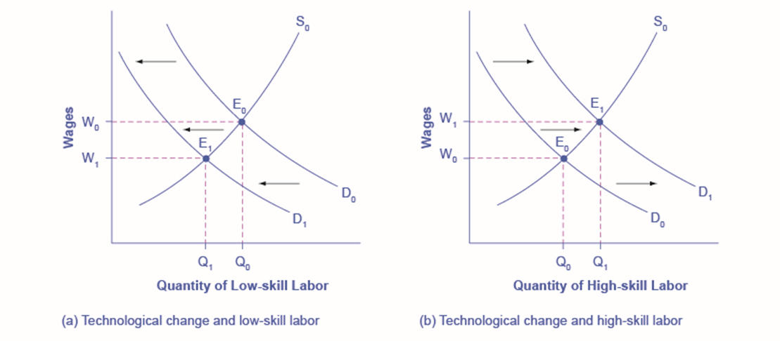
Figure 4.3
The demand for low-skill labor shifts to the left when technology can do the job previously done by these workers.
New technologies can also increase the demand for high-skill labor in fields such as information technology and network administration.

Slide 5
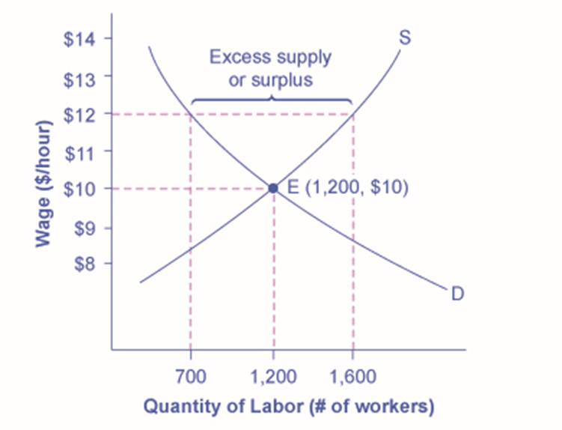
Figure 4.4
The original equilibrium in this labor market is a wage of $10/hour and a quantity of 1,200 workers, shown at point E. Imposing a wage floor at $12/hour leads to an excess supply of labor. At that wage, the quantity of labor supplied is 1,600 and the quantity of labor demanded is only 700.

Slide 6
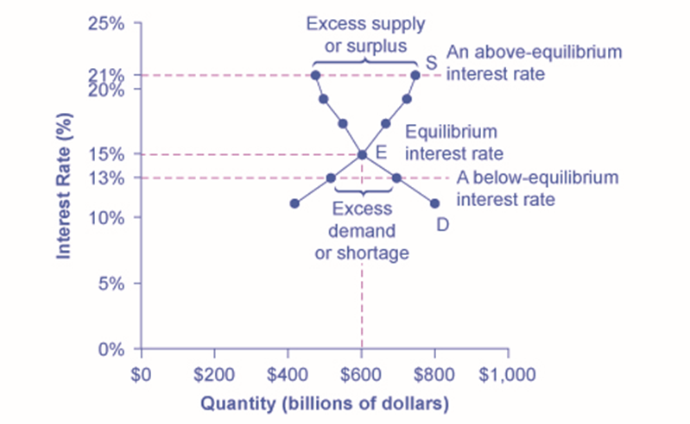
Figure 4.5
In this market for credit card borrowing, the demand curve (D) for borrowing financial capital intersects the supply curve (S) for lending financial capital at equilibrium E. At the equilibrium, the interest rate (the “price” in this market) is 15% and the quantity of financial capital being loaned and borrowed is $600 billion. The equilibrium price is where the quantity demanded and the quantity supplied are equal. At an above-equilibrium interest rate like 21%, the quantity of financial capital supplied would increase to $750 billion, but the quantity demanded would decrease to $480 billion. At a below-equilibrium interest rate like 13%, the quantity of financial capital demanded would increase to $700 billion, but the quantity of financial capital supplied would decrease to $510 billion.

Slide 7
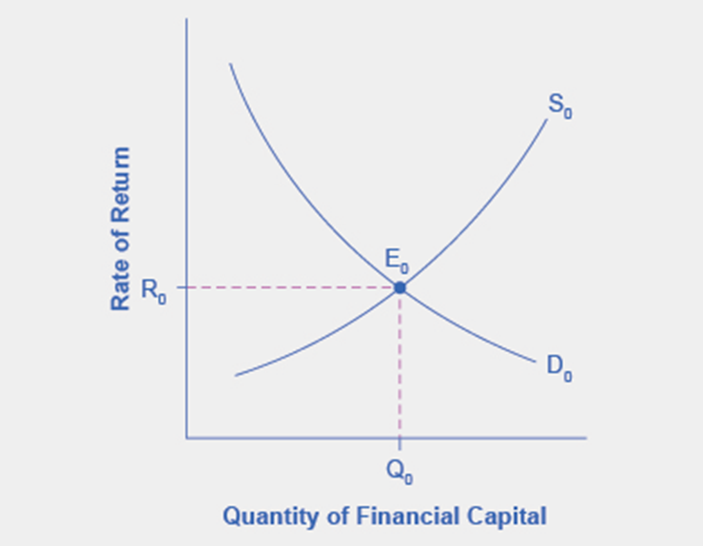
Figure 4.6
The graph shows the demand for financial capital from and supply of financial capital into the U.S. financial markets by the foreign sector before the increase in uncertainty regarding U.S. public debt. The original equilibrium (E₀) occurs at an equilibrium rate of return (R₀) and the equilibrium quantity is at Q₀.

Slide 8
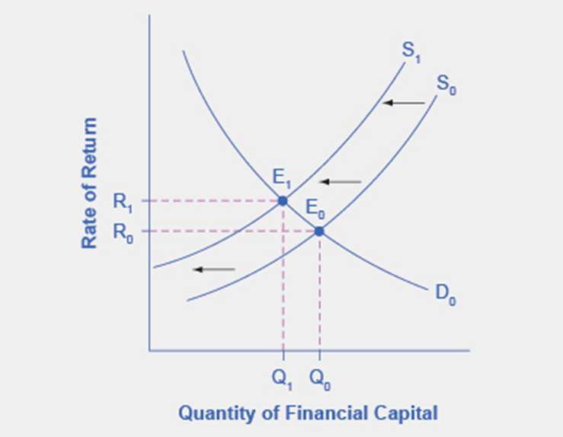
Figure 4.7
The graph shows the demand for financial capital and supply of financial capital into the U.S. financial markets by the foreign sector before and after the increase in uncertainty regarding U.S. public debt. The original equilibrium (E₀) occurs at an equilibrium rate of return (R₀) and the equilibrium quantity is at Q₀.

Slide 9
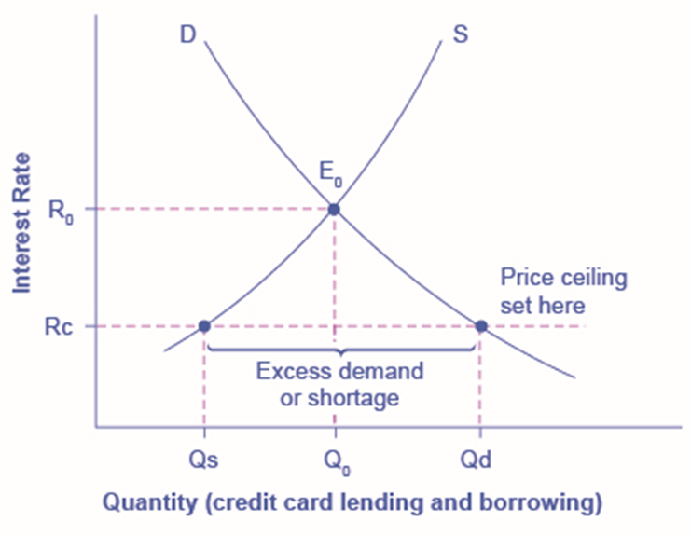
Figure 4.8
The original intersection of demand D and supply S occurs at equilibrium E₀. However, a price ceiling is set at the interest rate Rc, below the equilibrium interest rate R₀, and so the interest rate cannot adjust upward to the equilibrium. At the price ceiling, the quantity demanded, Qd, exceeds the quantity supplied, Qs. There is excess demand, also called a shortage.

Slide 10
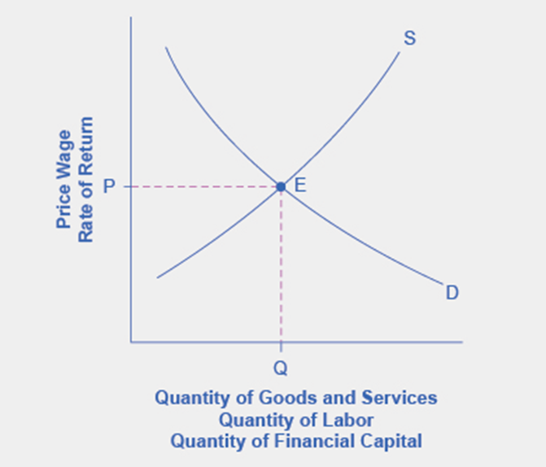
Figure 4.9
The figure displays a generic demand and supply curve. The horizontal axis shows the different measures of quantity: a quantity of a good or service, a quantity of labor for a given job, or a quantity of financial capital. The vertical axis shows a measure of price: the price of a good or service, the wage in the labor market, or the rate of return (like the interest rate) in the financial market. The demand and supply curves can be used to explain how economic events will cause changes in prices, wages, and rates of return.

Slide 11
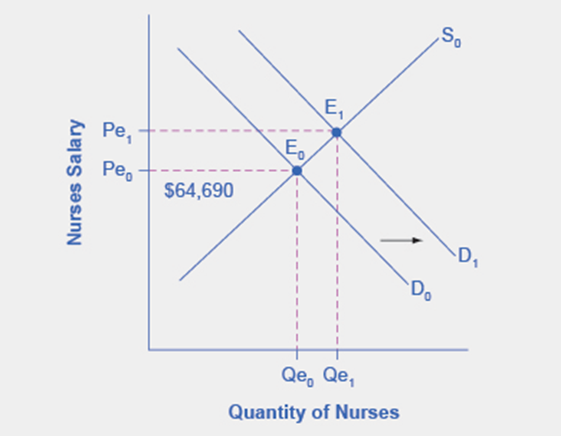
Figure 4.10
In 2010, the median salary for nurses was $64,690. As demand for services increases, the demand curve shifts to the right (from D₀ to D₁) and the equilibrium quantity of nurses increases from Qe₀ to Qe₁. The equilibrium salary increases from Pe₀ to Pe₁.

Slide 12
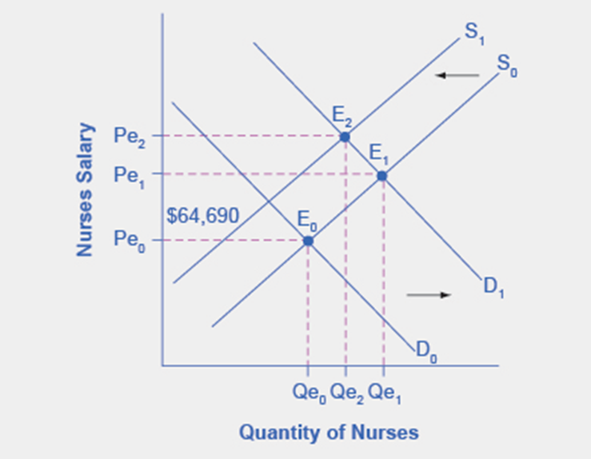
Figure 4.11
Initially, salaries increase as demand for nursing increases to Pe₁. When demand increases, so too does the equilibrium quantity, from Qe₀ to Qe₁. The decrease in the supply of nurses due to nurses retiring from the workforce and fewer nursing graduates (ceterus paribus), causes a leftward shift of the supply curve resulting in even higher salaries for nurses, at Pe₂, but an uncertain outcome for the equilibrium quantity of nurses, which in this representation is less than Qe₁, but more than the initial Qe₀.

