Slide 1

Principles of microEconomics
Chapter 2 Choice in a World of Scarcity
PowerPoint Image Slideshow

Slide 2

Figure 2.1
In general, the higher the degree, the higher the salary. So why aren’t more people pursuing higher degrees? The short answer: choices and tradeoffs. (Credit: modification of work by “Jim, the Photographer”/Flickr Creative Commons)

Slide 3
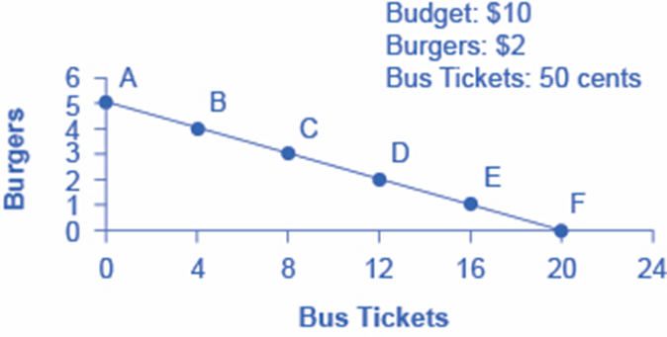
Figure 2.2
Each point on the budget constraint represents a combination of burgers and bus tickets whose total cost adds up to Alphonso’s budget of $10. The slope of the budget constraint is determined by the relative price of burgers and bus tickets. All along the budget set, giving up one burger means gaining four bus tickets.

Slide 4
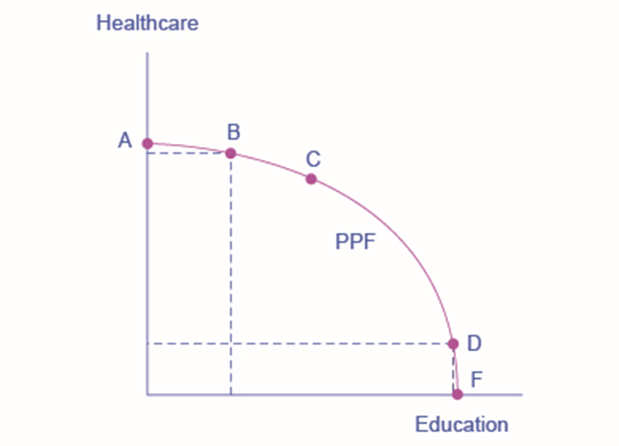
Figure 2.3
This production possibilities frontier shows a tradeoff between devoting social resources to healthcare and devoting them to education. At A all resources go to healthcare and at B, most go to healthcare. At D most resources go to education, and at F, all go to education.

Slide 5
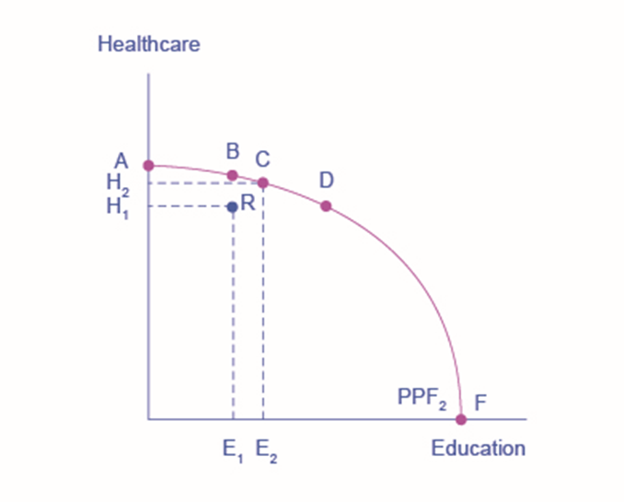
Figure 2.4
Productive efficiency means it is impossible to produce more of one good without decreasing the quantity that is produced of another good. Thus, all choices along a given PPF like B, C, and D display productive efficiency, but R does not. Allocative efficiency means that the particular mix of goods being produced—that is, the specific choice along the production possibilities frontier—represents the allocation that society most desires.

Slide 6
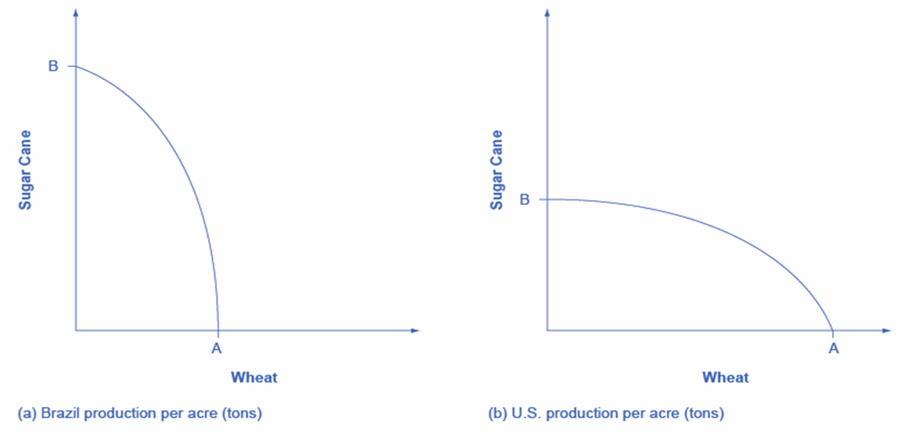
Figure 2.5
The U.S. PPF is flatter than the Brazil PPF implying that the opportunity cost of wheat in term of sugar cane is lower in the U.S. than in Brazil. Conversely, the opportunity cost of sugar cane is lower in Brazil. The U.S. has comparative advantage in wheat and brazil has comparative advantage in sugar cane.

Slide 7
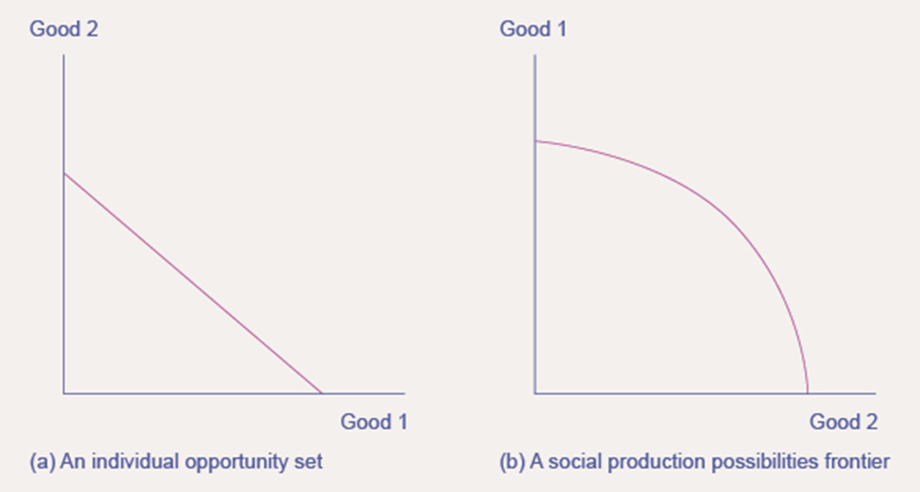
Figure 2.6
Both the individual opportunity set (or budget constraint) and the social production possibilities frontier show the constraints under which individual consumers and society as a whole operate. Both diagrams show the tradeoff in choosing more of one good at the cost of less of the other.

