Slide 1

Principles of microEconomics
Chapter 1 Welcome to Economics!
PowerPoint Image Slideshow

Slide 2

Figure 1.1
Economics is greatly impacted by how well information travels through society. Today, social media giants Twitter, Facebook, and Instagram are major forces on the information super highway. (Credit: modification of work by Manuel Iglesias/Flickr Creative Commons)

Slide 3
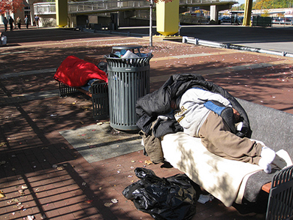
Figure 1.2
Homeless people are a stark reminder that scarcity of resources is real. (Credit: “daveynin”/Flickr Creative Commons)

Slide 4
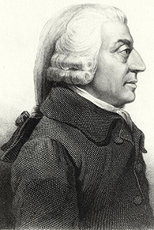
Figure 1.3
Adam Smith introduced the idea of dividing labor into discrete tasks. (Credit: Wikimedia Commons)

Slide 5
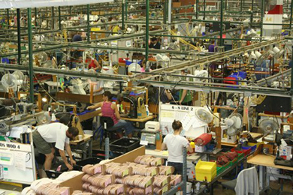
Figure 1.4
Workers on an assembly line are an example of the divisions of labor. (Credit: Nina Hale/Flickr Creative Commons)

Slide 6
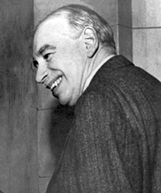
Figure 1.5
One of the most influential economists in modern times was John Maynard Keynes. (Credit: Wikimedia Commons)

Slide 7
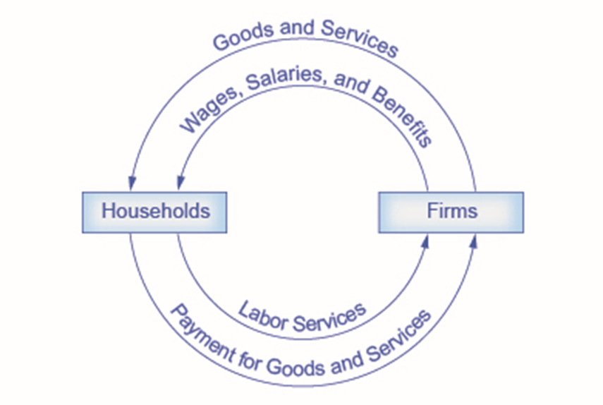
Figure 1.6
The circular flow diagram shows how households and firms interact in the goods and services market, and in the labor market. The direction of the arrows shows that in the goods and services market, households receive goods and services and pay firms for them. In the labor market, households provide labor and receive payment from firms through wages, salaries, and benefits.

Slide 8
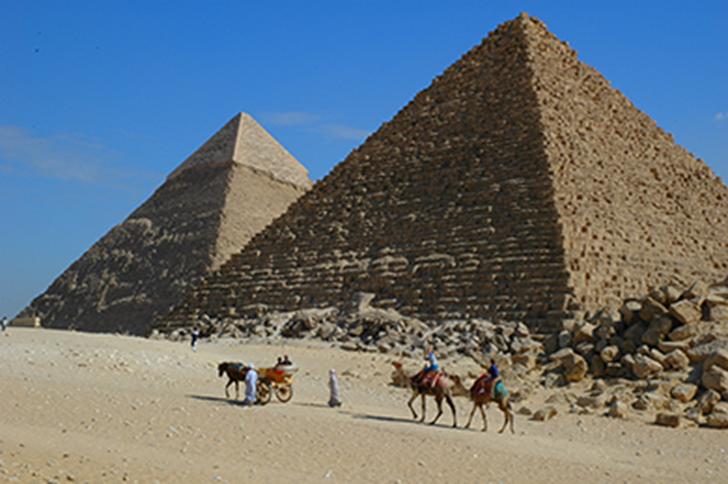
Figure 1.7
Ancient Egypt was an example of a command economy. (Credit: Jay Bergesen/Flickr Creative Commons)

Slide 9
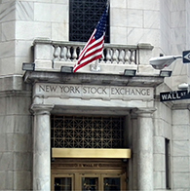
Figure 1.8
Nothing says “market” more than The New York Stock Exchange. (Credit: Erik Drost/Flickr Creative Commons)

Slide 10
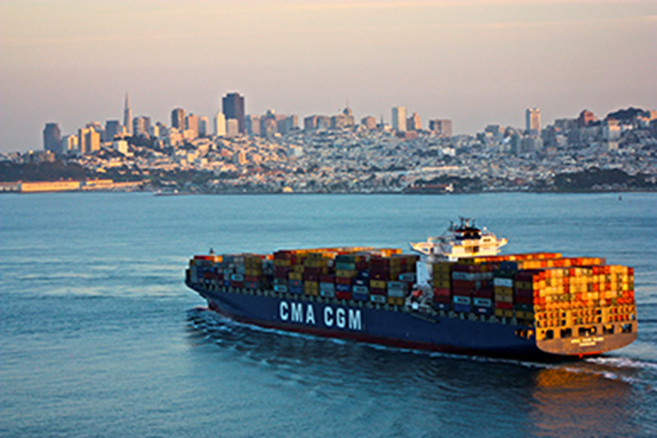
Figure 1.9
Cargo ships are one mode of transportation for shipping goods in the global economy. (Credit: Raul Valdez/Flickr Creative Commons)

