Slide 1

Principles of microEconomics
Chapter 13 Positive Externalities and Public Goods
PowerPoint Image Slideshow

Slide 2
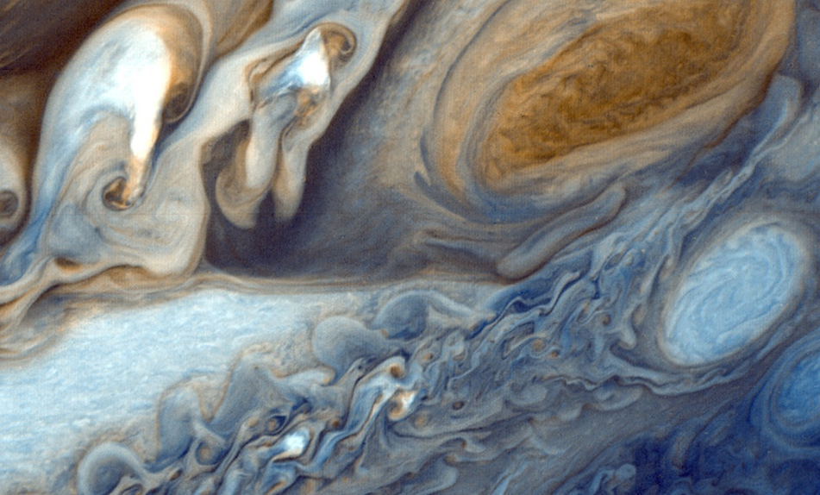
Figure 13.1
Launched by NASA on September 5, 1977, Voyager 1’s primary mission was to provide detailed images of Jupiter, Saturn, and their moons. It took this photograph of Jupiter on its journey. In August of 2012, Voyager I entered interstellar space—the first human-made object to do so—and it is expected to send data and images back to earth until 2025. Such a technological feat has a lot to do with economic principles. (Credit: modification of work by NASA/JPL)

Slide 3
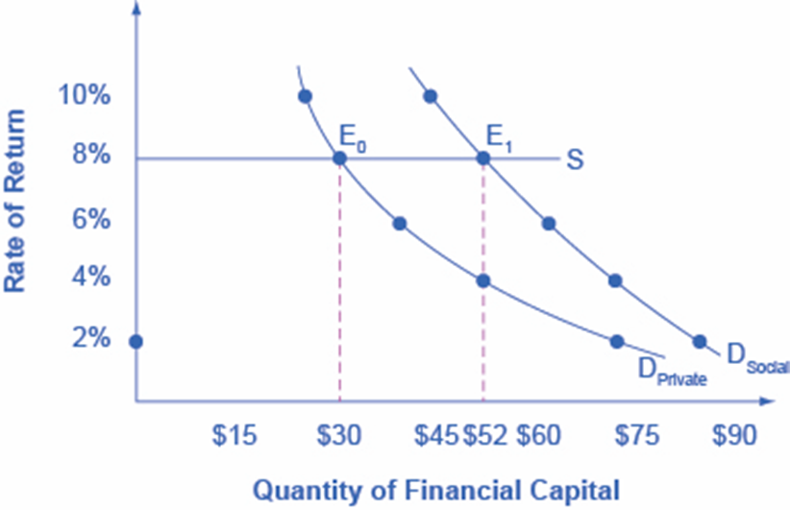
Figure 13.2
Big Drug faces a cost of borrowing of 8%. If the firm receives only the private benefits of investing in R&D, then its demand curve for financial capital is shown by D_{Private}, and the equilibrium will occur at $30 million. Because there are spillover benefits, society would find it optimal to have $52 million of investment. If the firm could keep the social benefits of its investment for itself, its demand curve for financial capital would be D_{Social} and it would be willing to borrow $52 million.

Slide 4
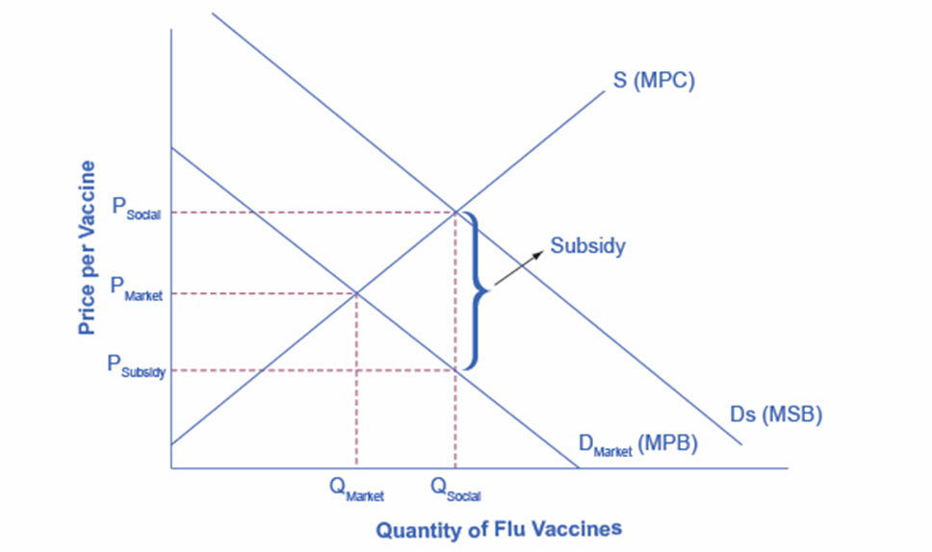
Figure 13.3
The market demand curve does not reflect the positive externality of flu vaccinations, so only Q_{Market} will be exchanged. This outcome is inefficient because the marginal social benefit exceeds the marginal social cost. If the government provides a subsidy to consumers of flu shots, equal to the marginal social benefit minus the marginal private benefit, the level of vaccinations can increase to the socially optimal quantity of Q_{Social}.

Slide 5
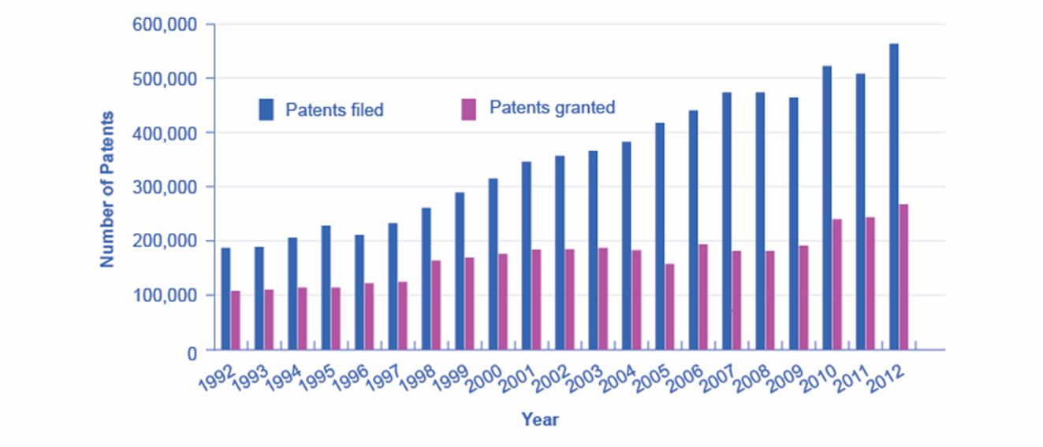
Figure 13.4
The number of applications filed for patents increased substantially from the mid-1990s into the first years of the 2000s, due in part to the invention of the Internet, which has led to many other inventions and to the 1998 Copyright Term Extension Act. (Source: http://www.uspto.gov/web/offices/ac/ido/oeip/taf/us_stat.htm)

