Slide 1

Principles of microEconomics
Chapter 9 Monopoly
PowerPoint Image Slideshow

Slide 2

Figure 9.1
In the mid-nineteenth century, the United States, specifically the Southern states, had a near monopoly in the cotton supplied to Great Britain. These states attempted to leverage this economic power into political power—trying to sway Great Britain to formally recognize the Confederate States of America. (Credit: modification of work by “ashleylovespizza”/Flickr Creative Commons)

Slide 3
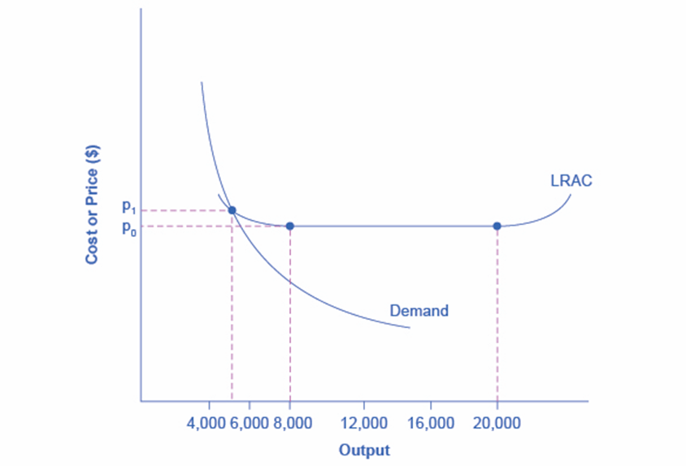
Figure 9.2
In this market, the demand curve intersects the long-run average cost (LRAC) curve at its downward-sloping part. A natural monopoly occurs when the quantity demanded is less than the minimum quantity it takes to be at the bottom of the long-run average cost curve.

Slide 4
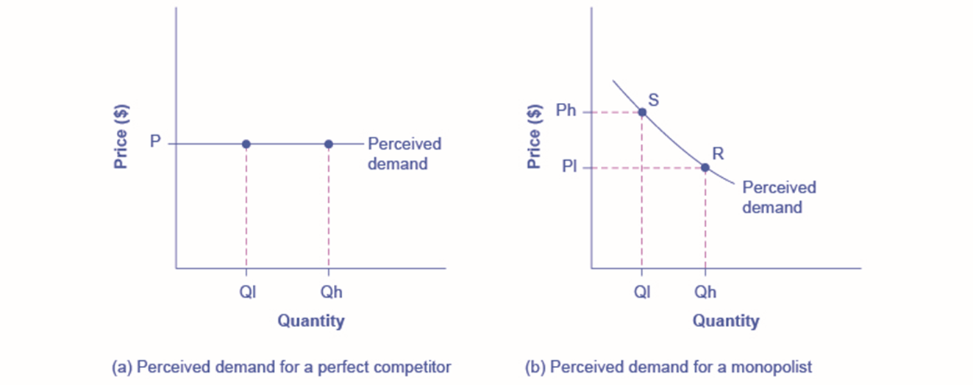
Figure 9.3
A perfectly competitive firm perceives the demand curve that it faces to be flat. The flat shape means that the firm can sell either a low quantity (Ql) or a high quantity (Qh) at exactly the same price (P).
A monopolist perceives the demand curve that it faces to be the same as the market demand curve, which for most goods is downward-sloping. Thus, if the monopolist chooses a high level of output (Qh), it can charge only a relatively low price (Pl); conversely, if the monopolist chooses a low level of output (Ql), it can then charge a higher price (Ph). The challenge for the monopolist is to choose the combination of price and quantity that maximizes profits.

Slide 5
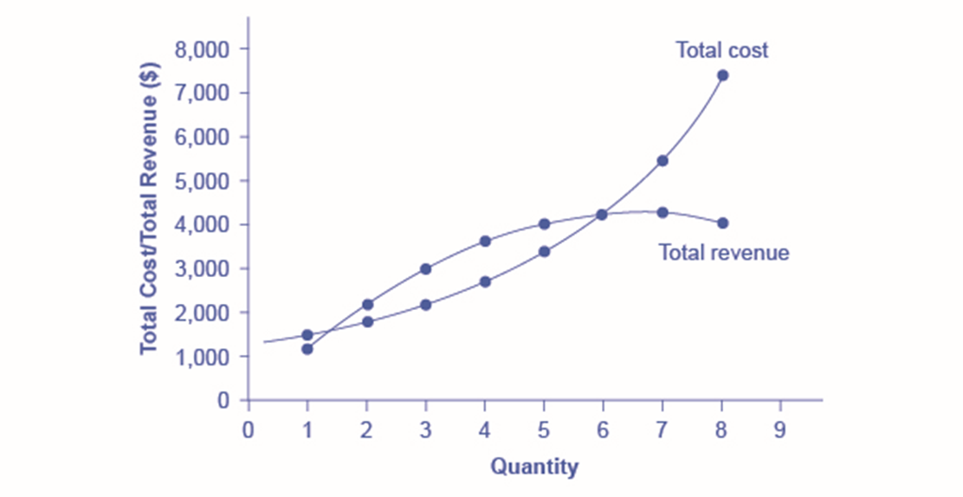
Figure 9.4
Total revenue for the monopoly firm called HealthPill first rises, then falls. Low levels of output bring in relatively little total revenue, because the quantity is low. High levels of output bring in relatively less revenue, because the high quantity pushes down the market price. The total cost curve is upward-sloping. Profits will be highest at the quantity of output where total revenue is most above total cost. Of the choices in Table 9.2, the highest profits happen at an output of 4. The profit-maximizing level of output is not the same as the revenue-maximizing level of output, which should make sense, because profits take costs into account and revenues do not.

Slide 6
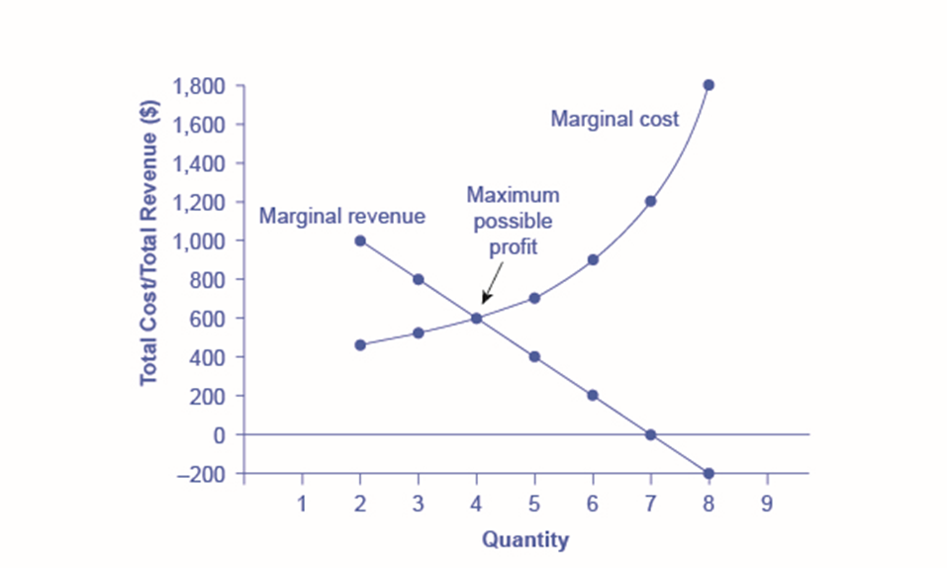
Figure 9.5
For a monopoly like HealthPill, marginal revenue decreases as additional units are sold. The marginal cost curve is upward-sloping. The profit-maximizing choice for the monopoly will be to produce at the quantity where marginal revenue is equal to marginal cost: that is, MR = MC. If the monopoly produces a lower quantity, then MR > MC at those levels of output, and the firm can make higher profits by expanding output. If the firm produces at a greater quantity, then MC > MR, and the firm can make higher profits by reducing its quantity of output.

Slide 7
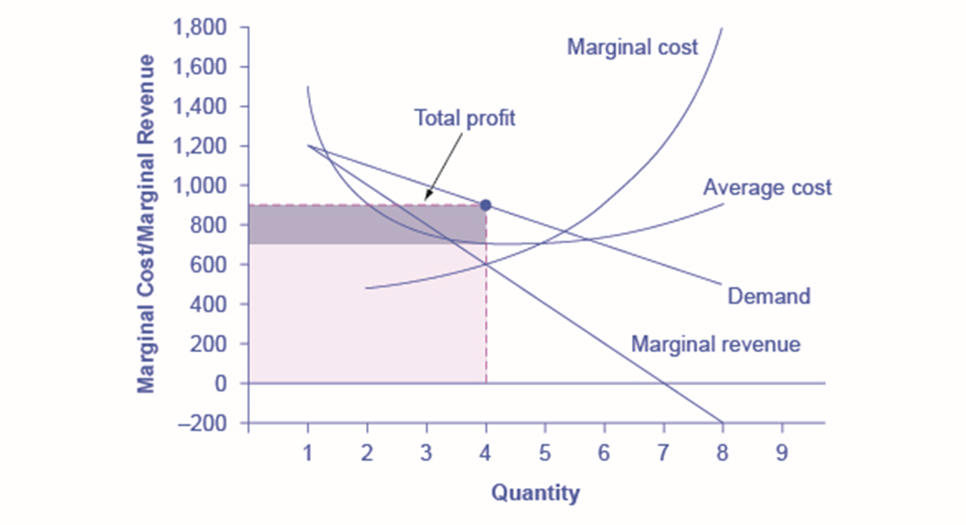
Figure 9.6
This figure begins with the same marginal revenue and marginal cost curves from the HealthPill monopoly presented in Figure 9.5. It then adds an average cost curve and the demand curve faced by the monopolist. The HealthPill firm first chooses the quantity where MR = MC; in this example, the quantity is 4. The monopolist then decides what price to charge by looking at the demand curve it faces. The large box, with quantity on the horizontal axis and marginal revenue on the vertical axis, shows total revenue for the firm. Total costs for the firm are shown by the lighter-shaded box, which is quantity on the horizontal axis and marginal cost of production on the vertical axis. The large total revenue box minus the smaller total cost box leaves the darkly shaded box that shows total profits. Since the price charged is above average cost, the firm is earning positive profits.

Slide 8
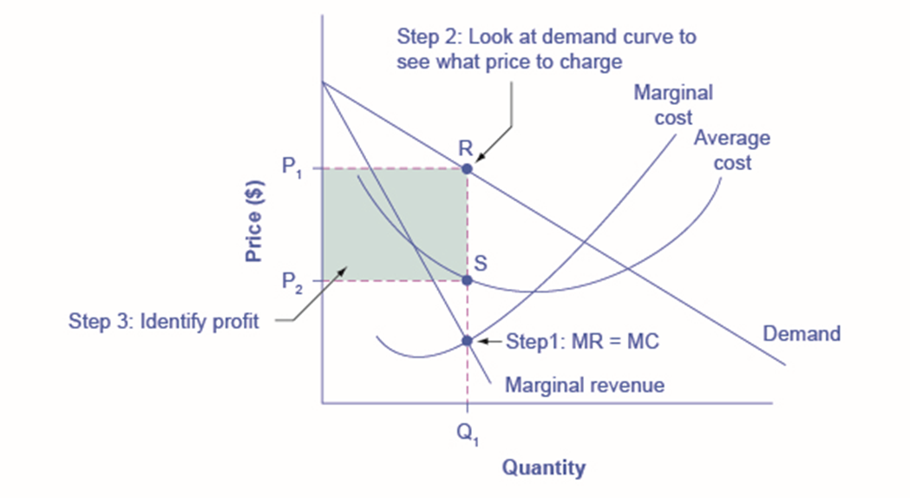
Figure 9.7
In Step 1, the monopoly chooses the profit-maximizing level of output Q₁, by choosing the quantity where MR = MC. In Step 2, the monopoly decides how much to charge for output level Q₁ by drawing a line straight up from Q₁ to point R on its perceived demand curve. Thus, the monopoly will charge a price (P₁). In Step 3, the monopoly identifies its profit. Total revenue will be Q₁ multiplied by P₁. Total cost will be Q₁ multiplied by the average cost of producing Q₁, which is shown by point S on the average cost curve to be P₂. Profits will be the total revenue rectangle minus the total cost rectangle, shown by the shaded zone in the figure.

Slide 9
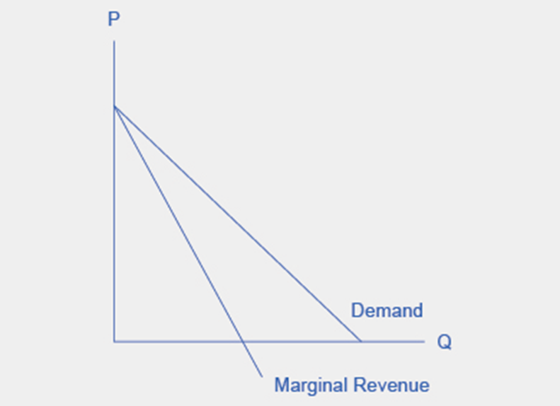
Figure 9.8
Because the market demand curve is conditional, the marginal revenue curve for a monopolist lies beneath the demand curve.

