Slide 1

Principles of microEconomics
Chapter 11 Monopoly and Antitrust Policy
PowerPoint Image Slideshow

Slide 2
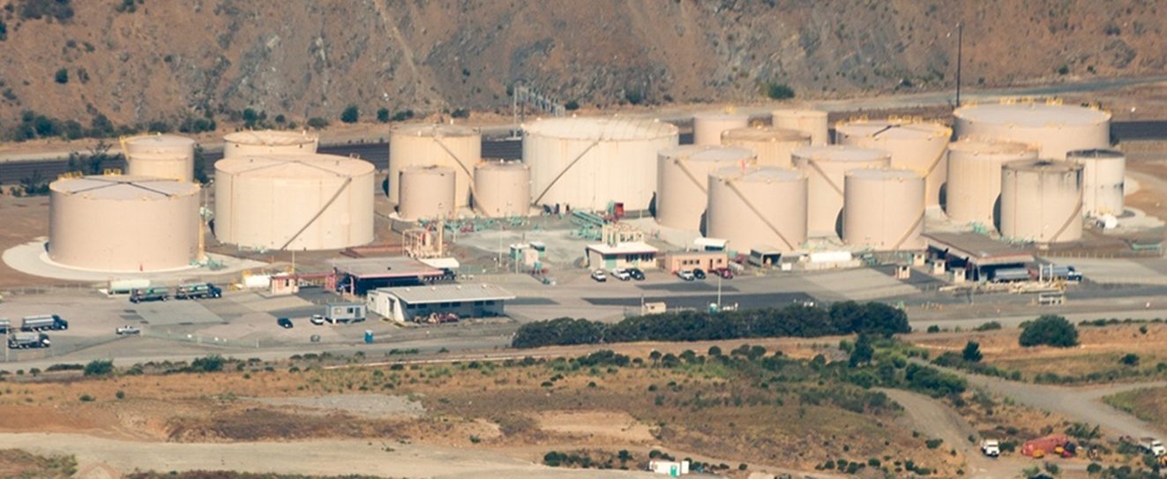
Figure 11.1
Large corporations, such as the natural gas producer Kinder Morgan, can bring economies of scale to the marketplace. Will that benefit consumers? Or is more competition better for consumers? (Credit: modification of work by Derrick Coetzee/Flickr Creative Commons)

Slide 3
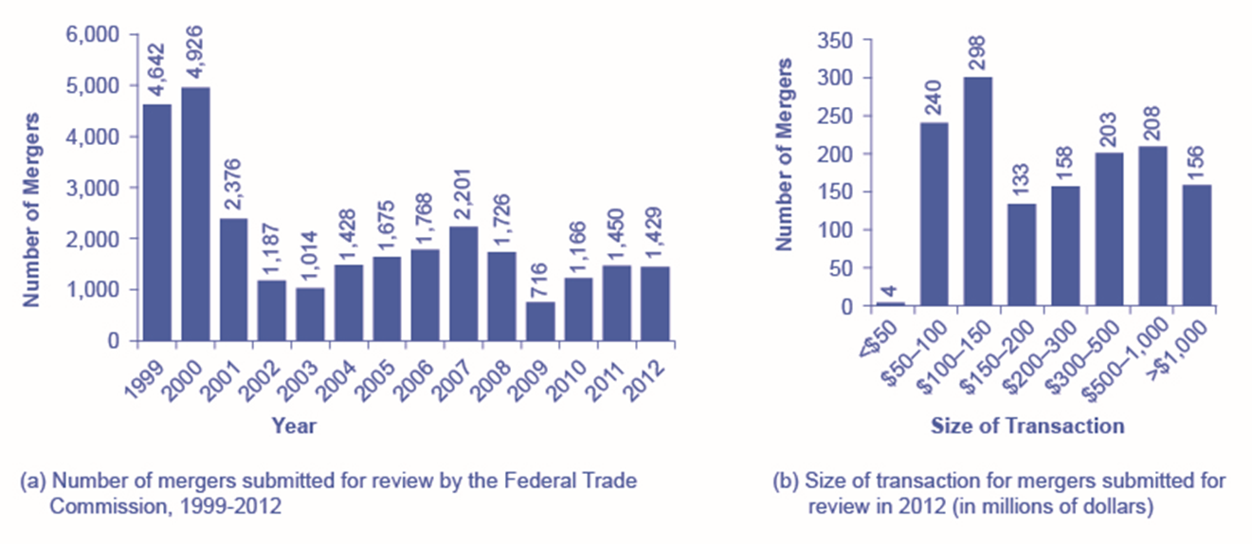
Figure 11.2
The number of mergers in 1999 and 2000 were relatively high compared to the annual numbers seen from 2001–2012. While 2001 and 2007 saw a high number of mergers, these were still only about half the number of mergers in 1999 and 2000.
In 2012, the greatest number of mergers submitted for review was for transactions between $100 and $150 million.

Slide 4
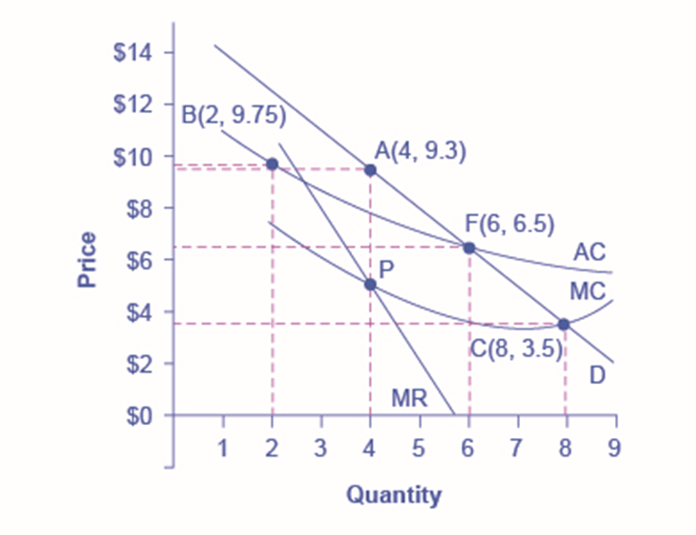
Figure 11.3
A natural monopoly will maximize profits by producing at the quantity where marginal revenue (MR) equals marginal costs (MC) and by then looking to the market demand curve to see what price to charge for this quantity. This monopoly will produce at point A, with a quantity of 4 and a price of 9.3. If antitrust regulators split this company exactly in half, then each half would produce at point B, with average costs of 9.75 and output of 2. The regulators might require the firm to produce where marginal cost crosses the market demand curve at point C. However, if the firm is required to produce at a quantity of 8 and sell at a price of 3.5, the firm will suffer from losses. The most likely choice is point F, where the firm is required to produce a quantity of 6 and charge a price of 6.5.

